Slide 1
Consultative Panel
On behalf of Forestry England
Sam Jones, Head of Recreation and Public Affairs
5 September 2024

Slide 2
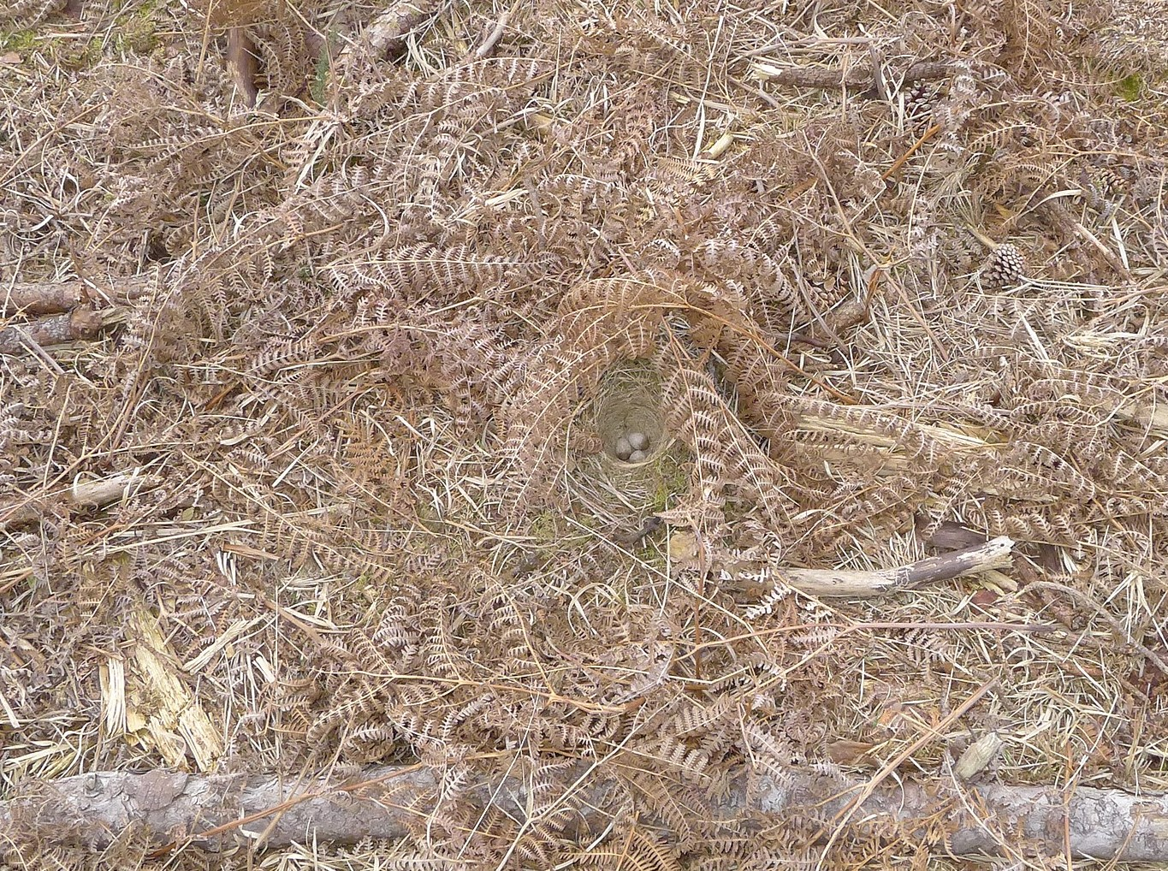

Caring for wildlife – Ground nesting birds
The breeding season for ground nesting birds has finished and our car parks have been re-opened. We’d like to thank everyone that’s helped to protect these rare chicks.
This year, over 100 volunteers from Hampshire Ornithological Society carried our woodlark surveys across 300kms of the New Forest. This included several areas of heathland that we’ve recently restored.
We’re looking forward to seeing the results, as this is key in helping us understand the benefits and impact of our long-term restoration programme across the open forest.
Notes:
The nesting season has now finished and we’ve re-opened the car parks and removed the signage, we’d like to thank everyone that’s helped to protect these rare birds this year.

Slide 3
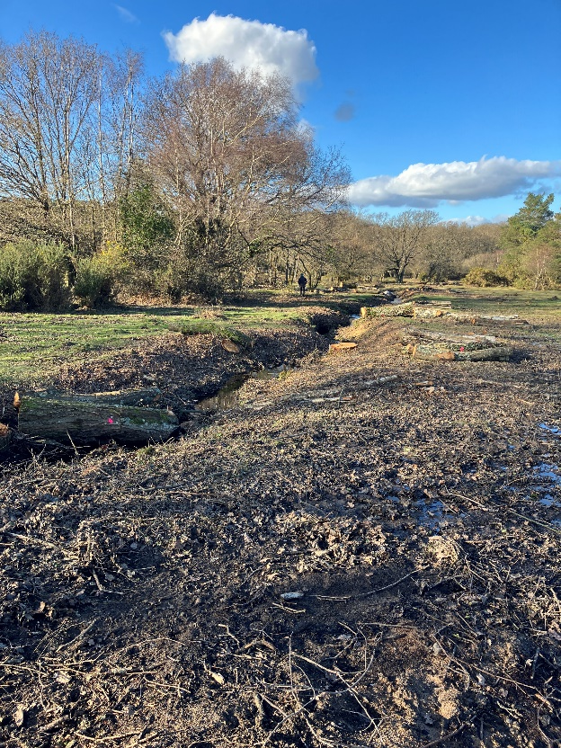
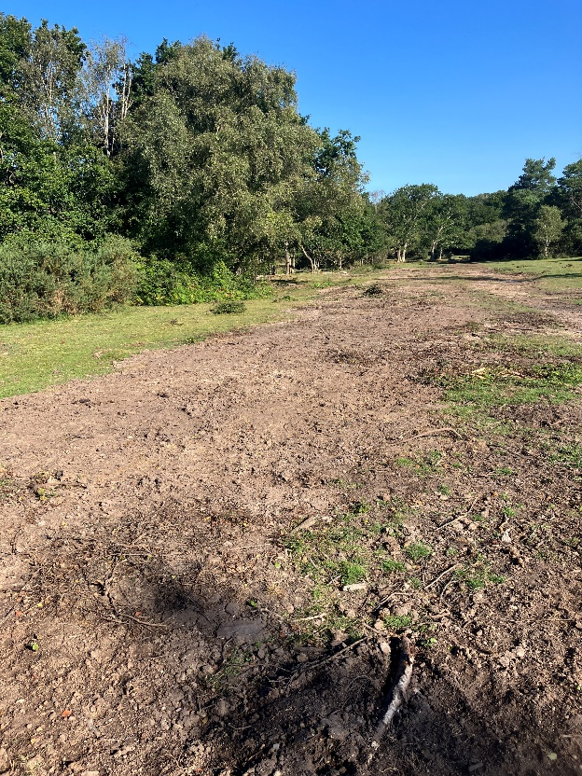
Caring for wildlife - Wetland restoration update
The HLS wetland restoration programme continues - this summer contractors returned to Penny Moor, an area previously worked, to infill an artificial drain and replace bridges with gravel ford crossings which will still allow access for forest animals but will not interrupt the flow. This restoration will help restore the natural hydrology and improve the wetland habitats.
Also, other small, wetland restoration projects were carried out at this spring/summer at: Anses Wood, Hawkhill Mire, Furzey Lodge Mire/Rans Wood and Ravens Nest Inclosure.
Over the past few years, Footprint Ecology have been developing an Evidence and Monitoring Plan for the Freshwater and Wetland Restoration Forum (FWRF). The plan, nearing completion with most sections approved by the forum, will help guide Forestry England and other forum members in gathering evidence and determining monitoring strategies for future restoration projects.
Furzey Lodge Mire/Rans Wood before and after photos

Slide 4
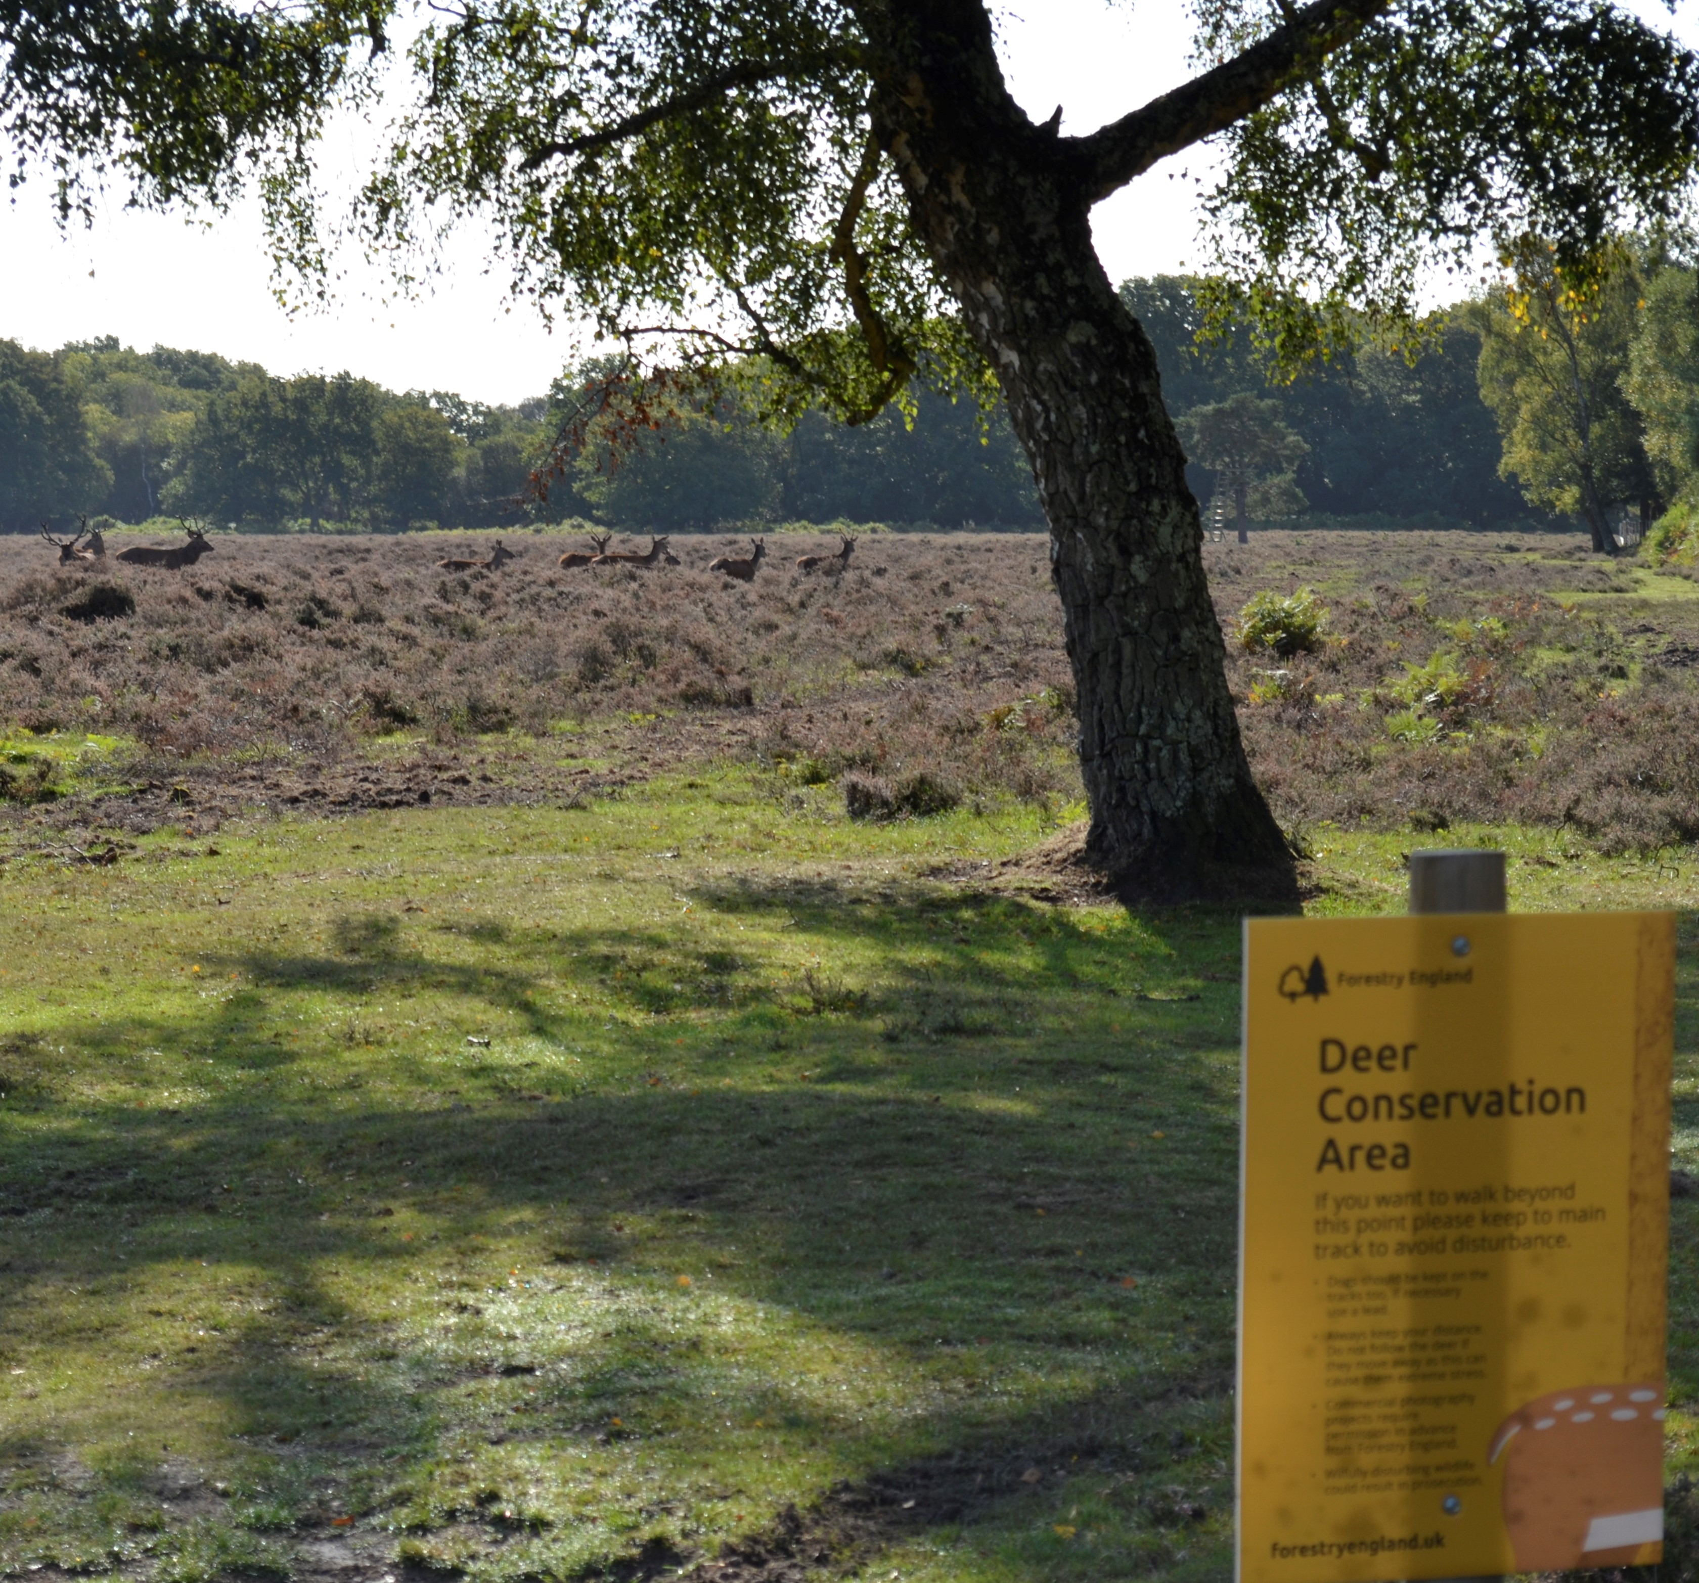
Caring for wildlife – deer rut
It’s the mating season for many deer, with red and fallow males fighting for territory.
Our staff will once again be reminding people to watch deer from a safe distance and don’t enter signposted areas.
Unfortunately, each year people are getting unacceptably close to the deer during the rutting season, which affects deer behaviour, with some wild herds not able to move freely.

Slide 5
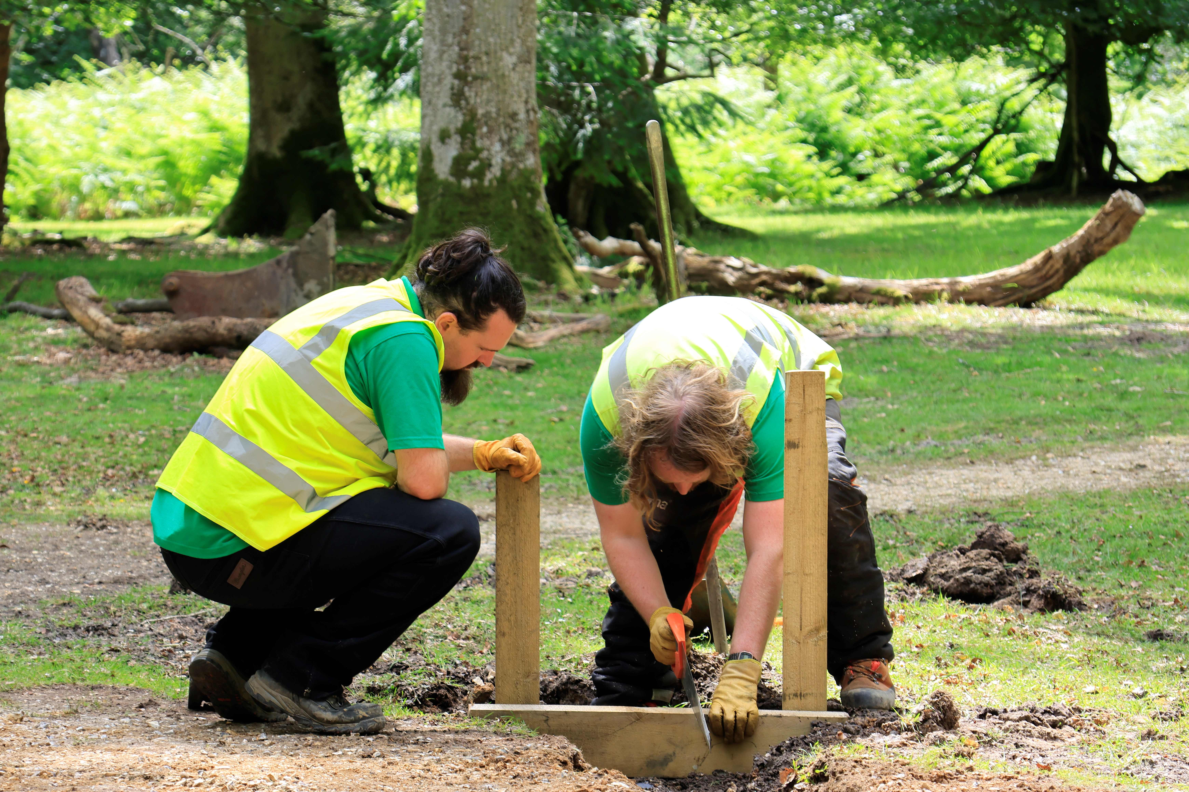
Welcoming people – access for all
We manage hundreds of miles of trails and paths right across the New Forest and it’s a year-round job for our staff.
In spring, our teams were busy upgrading paths and access points at Knightwood Oak. A new, level path surface has been laid with extra drainage to help it stay drier in winter. It’s also been widened and access to it improved for mobility vehicles, wheelchairs and push chairs. In the car park, the team have added an additional disabled parking bay.
This work was funded through the NPA’s Access for All, Defra fund.

Slide 6
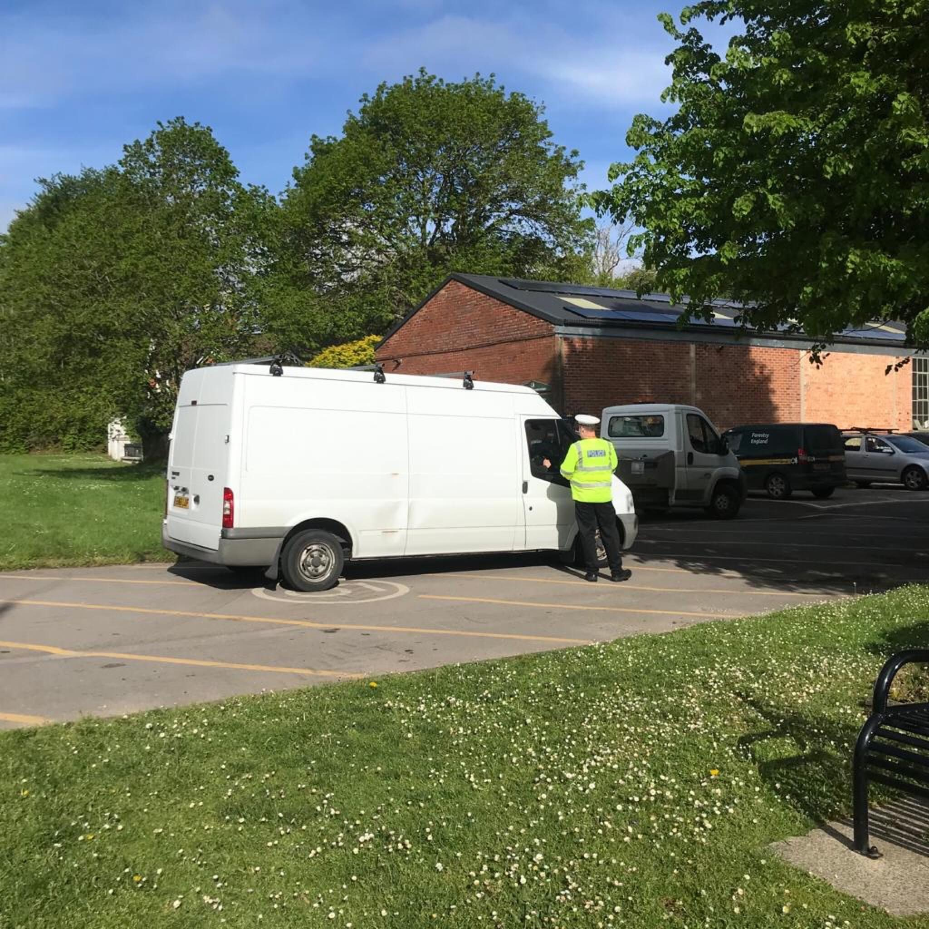
Welcoming people – tackling fly-tipping
Fly-tipping is a major issue across England, the New Forest ranked at 200 in a list of over 300 Local Authorities.
Working with NFDC, the police, VOSPA and the NPA, our teams are carrying out random spot check on vehicles carrying waste. Last year this resulted in 200 vehicles being stopped and 50 charged for offences.
We also run a public education campaign, shared by local forest partners, on social media and at events – advising the public how important it is to check that anyone they use to remove waste must have a licence to do so. This campaign highlights how we’re proactivity tackling offenders in the New Forest, and we’re increasingly seeing more commercial waste being dumped – builders’ rubble, commercial house clearances, etc.

Slide 7
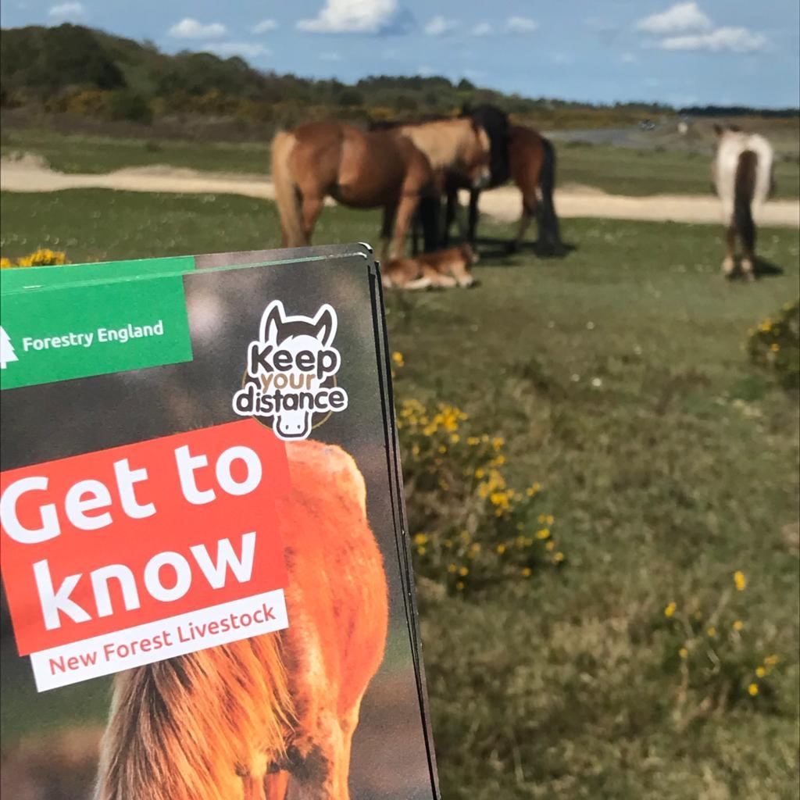
Welcoming people – New Forest ponies
Our Ranger team continue to remind people about not feeding and petting ponies.
Reminding them that it’s a fineable offence to feed or leave food out for New Forest ponies and donkeys.
Our team are also involved with the drifts at this time of year, opening and closing our car parks to facilitate the drifts and supporting with public safety at each event.

Slide 8
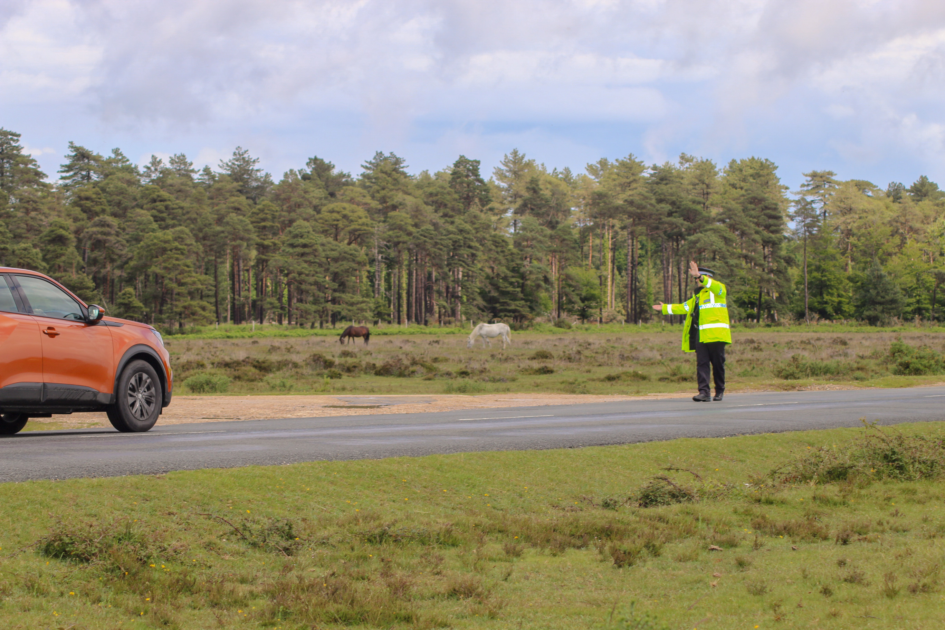
Welcoming People – Operation Mountie
We continue to be part of Operation Mountie, a multi-agency approach to reducing speed and animal deaths across the New Forest, regularly carrying our patrols at hot spots, like Roger Penny Way.
Hampshire Constabulary gave more drivers tickets for speeding and other drivers were spoken to by the New Forest Roads Awareness Team and Forestry England staff and given advice about why New Forest roads are so special.

Slide 9
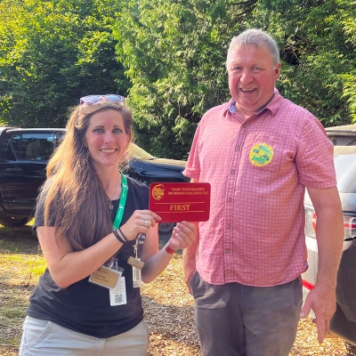
Welcoming people – New Forest Show
Forestry England won New Forest Show ‘Best Stand’ Award!
Forestry England's presence at the show remains a key feature of the event, with our displays occupying the large ‘Forest Activity Zone’ at the back of the showground.
Our area was awarded First Place in the Trade Stand Maldwin Drummond Challenge Cup.
This award recognises local agricultural, horticultural and forestry organisations that have provided an excellent visitor experience.

Slide 10
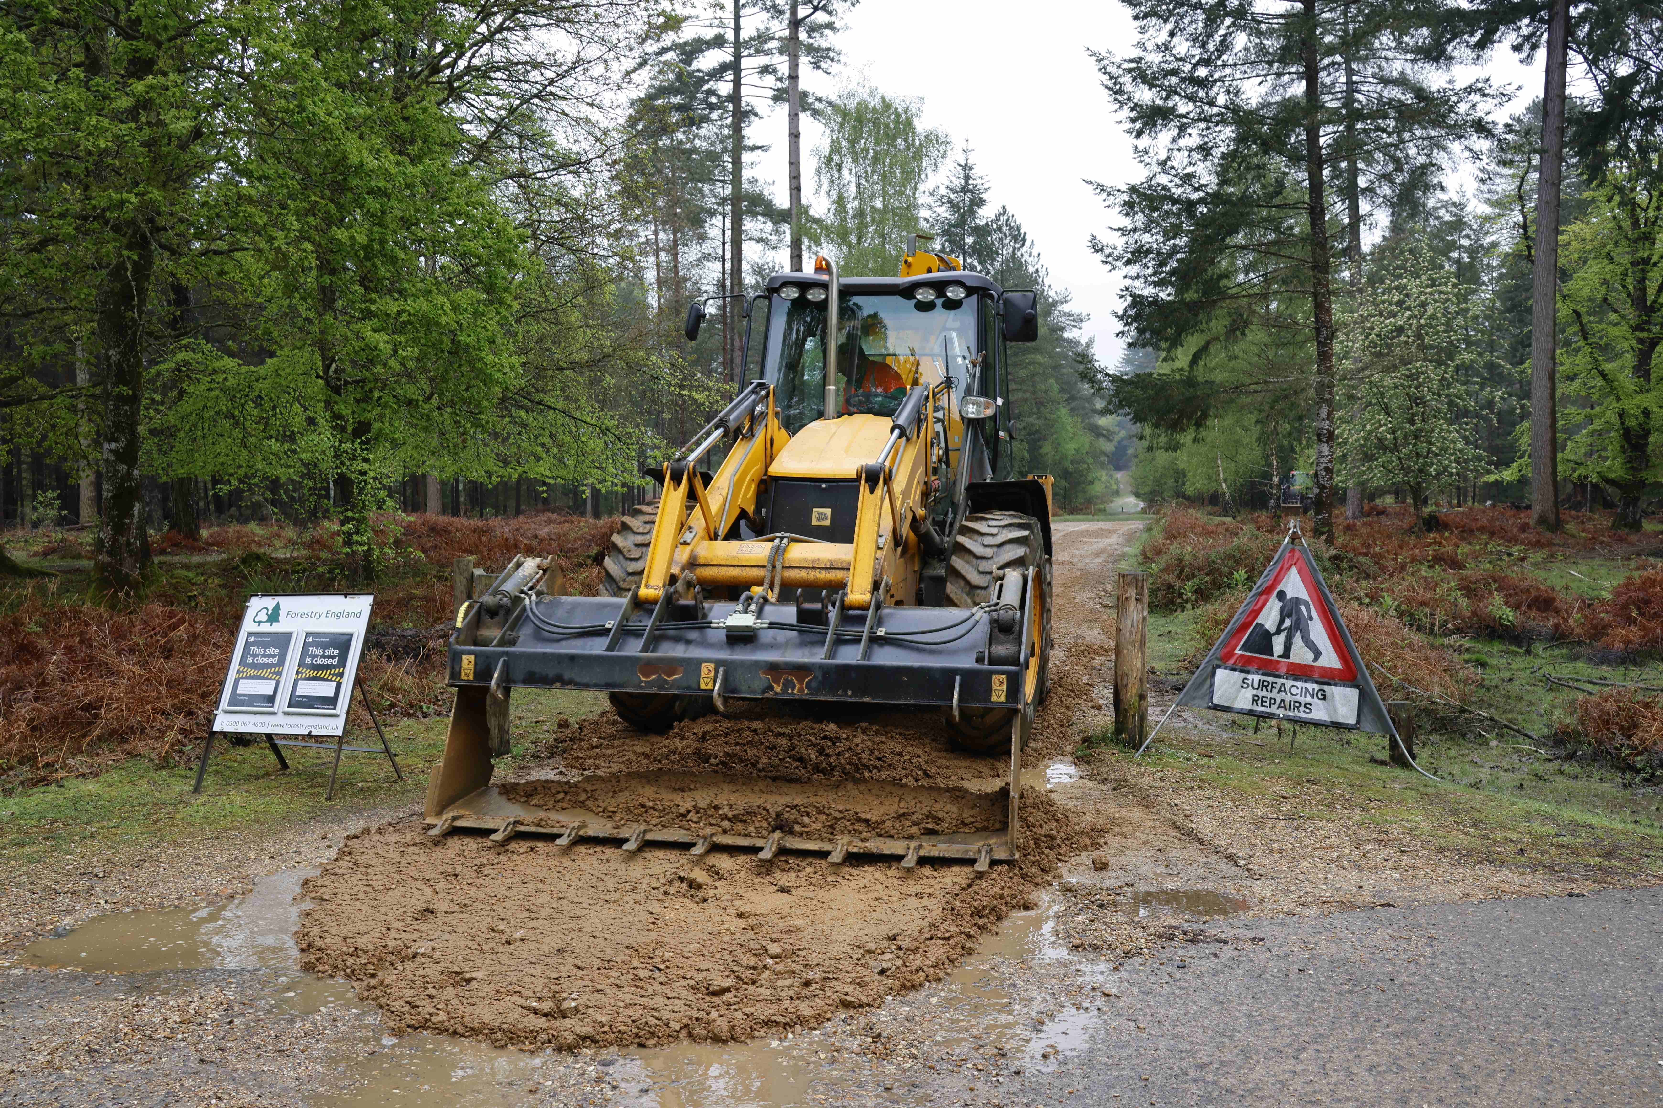
Welcoming people – our car parks
We try our best to keep on top of maintaining our gravel tracks and car parks, but our budgets and staff resources are very stretched, and a huge amount of damage occurred during the wet winter and spring.
Despite this, we’ve carried out repairs to 52 of our 130 car parks since April. This rolling programme will continue – it’s a big-scale operation and there’s a lot to do, like many other organisations we are feeling the impact of the uncertain financial climate and higher inflation, which means that resources are tight.

Slide 11

Climate change – forest fire risk
Our staff continue to deal with small campfires and BBQs that have been reported to us or found by our staff on their patrols.
They also continue to enforce the PSPO that’s in place in the New Forest, which bans the use of BBQs and fires of any kind.
We continue to work closely with the Hampshire Fire and Rescues Service on sharing key messages, reminding people that the New Forest is a strictly no fire or BBQ zone.

Slide 12
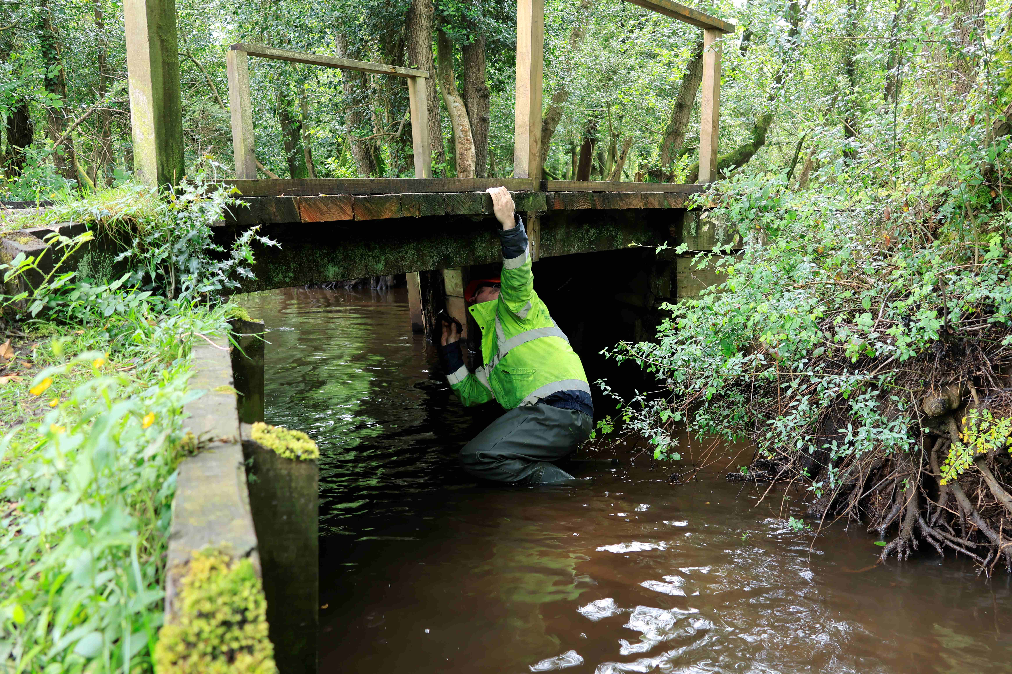
Sustainably producing timber- Bridge repairs
Our staff look after 284 wooden bridges across the Forest, carrying out regular inspections and repairs.
We’ve recently replaced one at Linford Bottom that links to our car park and provides important access for local residents. It follows a major upgrade to the car park and tracks that took place earlier this year. The team also resurfaced the surrounding access road using 250 tonnes of tarmac and 26 tonnes of locally sourced gravel.
We’ve also carried out major repairs to other bridges in Anderwood and Brownhill Inclosure.

Slide 13
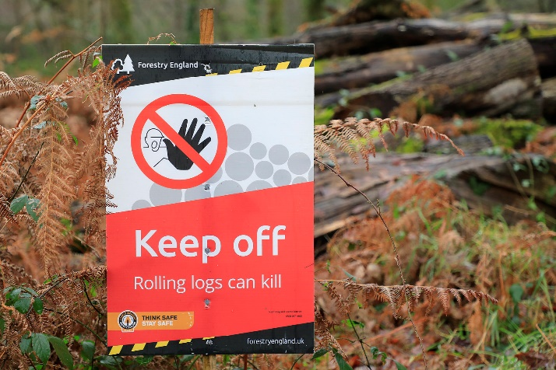
Sustainably producing timber- Forestry work update
Forestry England’s contractors have a busy programme of works in the New Forest thinning out some trees to give the remaining ones more space to grow.
We’re able to share and care for amazing places and incredible wildlife because of the timber we produce.
There are currently forestry activities in the following areas enclosed for growing trees: Burley New, Sloden and Alderhill, North Slufters, Brownhill, Parkhill, and Rhinefield Sandys/Vinney.
And on Ober Heath.
Notes:
Few of us stop to make the connection with our local woodlands and the supply of responsibly produced wood for products that are part of our daily lives. The wood from trees that have been recently thinned from the inclosures will be used for products like garden sheds, fence panels, gates and posts and pallets. The remaining trees will carry on growing.

Slide 14
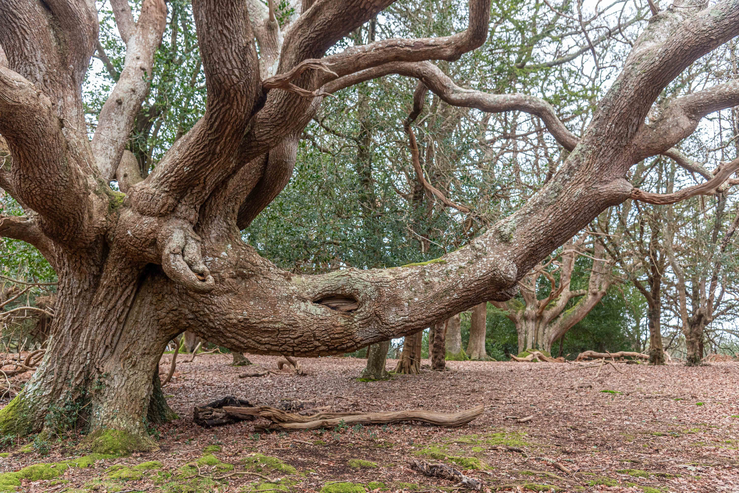
And finally…
We’re delighted that this ancient oak tree, nicknamed the elephant oak, in Old Sloden Inclosure, has been nominated for ‘Tree of the year’ - annual competition to raise awareness of the UK’s ancient, organised by the Woodland Trust.
Voting for this year’s ‘Tree of the Year’ is open until 21 October via the Woodland Trust website, with a winner announced on 29 October.

