Slide 1
Rural Policing Update
Strategic Rural Policing Inspector
Hampshire & IOW
Korine Bishop

Slide 2
Overview
85% Hampshire and IOW is defined as rural
Equates to 26% of the population
12% of crime occurs in rural areas
Traditional Policing approach suites urban areas

Slide 3
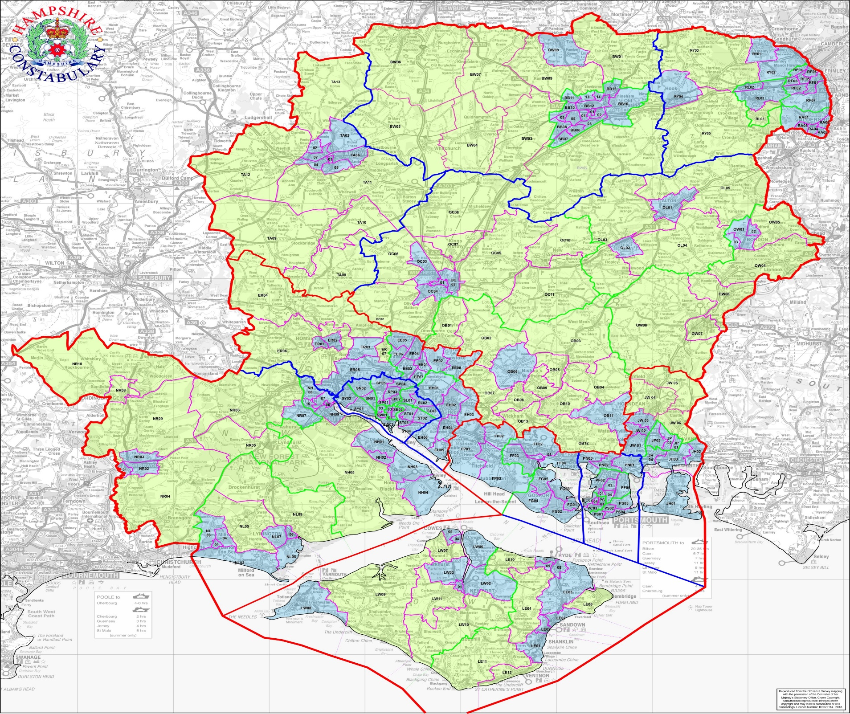
Notes:
Approximately 21% of our population live in the green bits.
About 12% of total crime happens in the green beats.

Slide 4


Slide 5
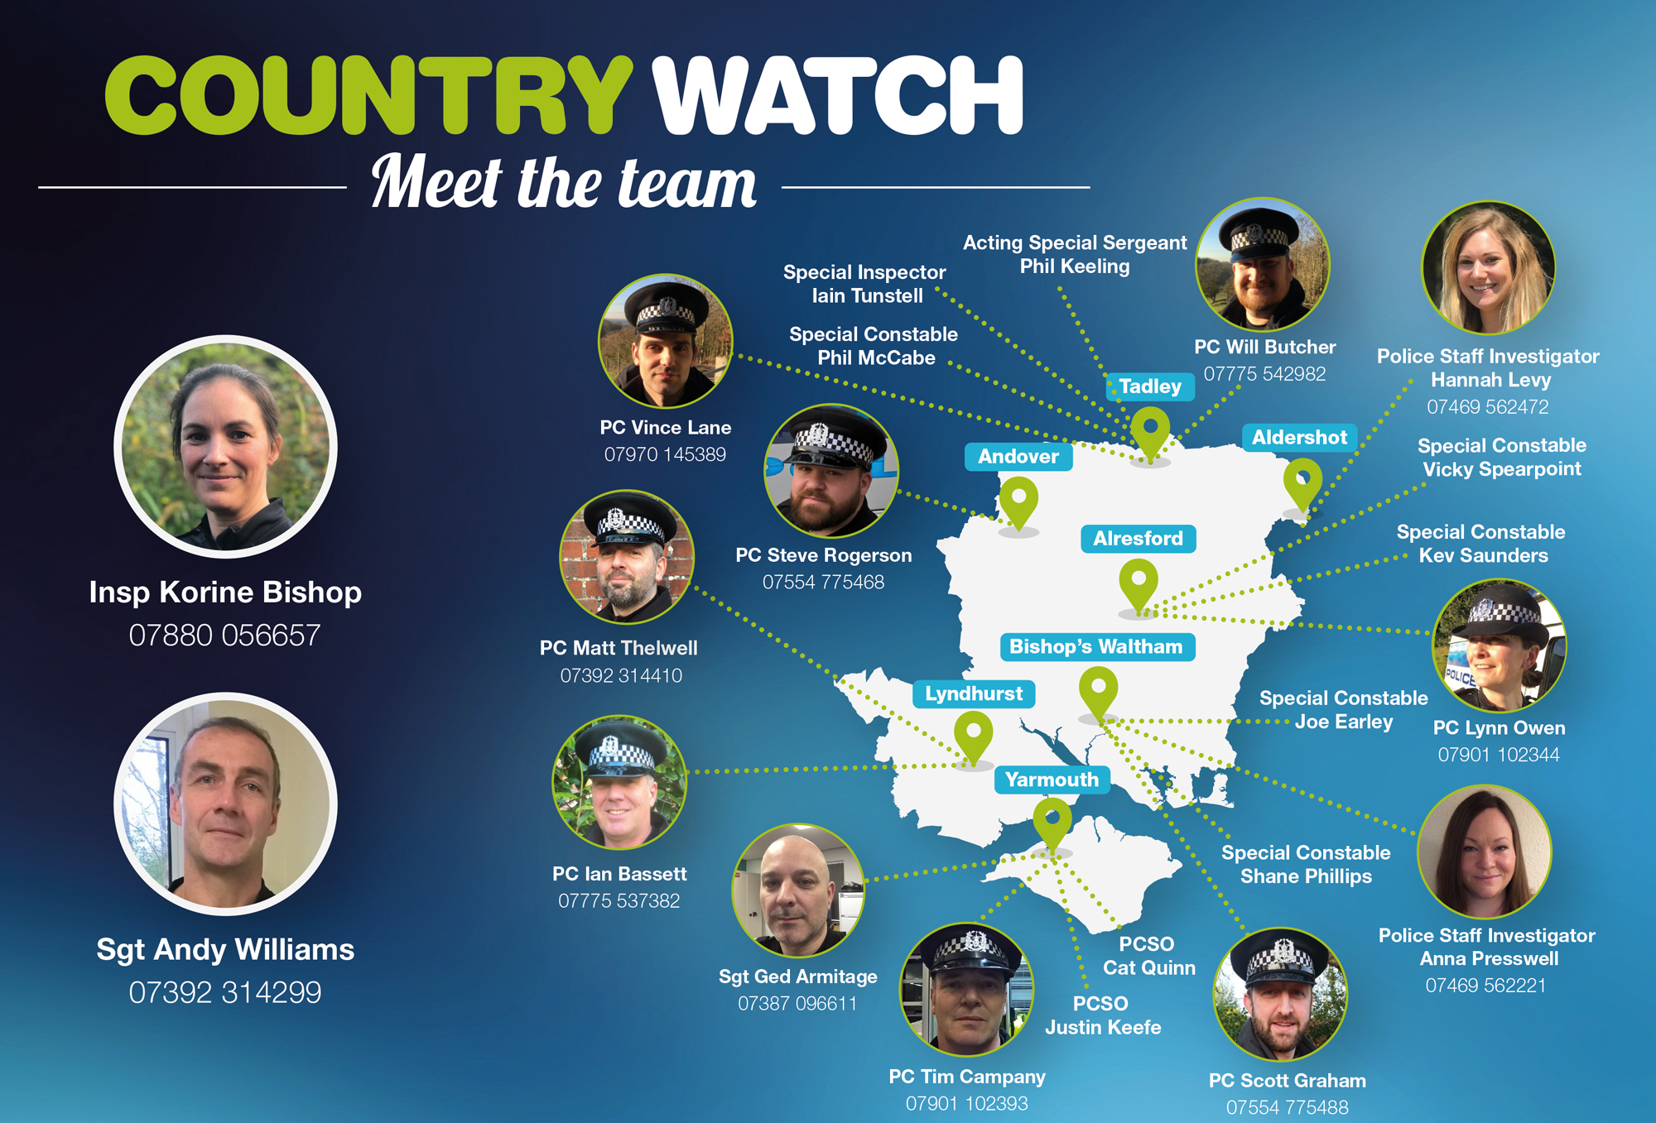
Notes:
We maintain our continued commitment to rural policing.
Dedicated Country Watch team supporting neighbourhood teams across the two counties.
Vacant post in the New Forest
3 PSI posts, one recruited starting after Xmas.
Team now consists of:
Inspector Korine Bishop
Sergeant Andrew Williams
6.5 PC’s based around Hampshire
PS and PC on the IOW
Designated team of Country Watch Specials

Slide 6

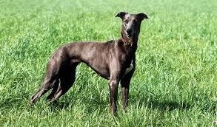
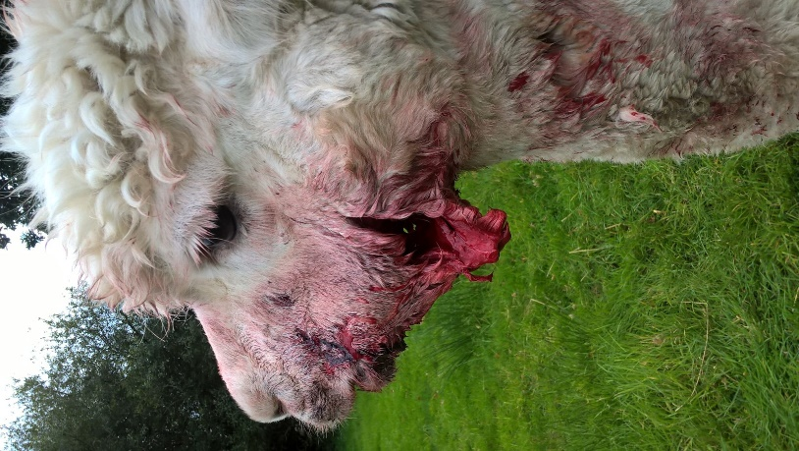
What do we do ?
The Country Watch teams will take OIC responsibility for the following types of investigations:
Plant Theft
Poaching
Dogs worrying livestock
Hunting/Shooting/fishing
Crime/incidents involving farm animal
Heritage crime
Protected land and habitats
Provide specialist advice and contacts for wildlife and rural issues
Notes:
Recorded as OIC in 414 jobs on RMS since 1st January 2017 (bearing in mind Corinne Irving hasn’t been here and Lynn is 2 days a week
Country Specials have been OIC for an additional 58 jobs – (Shane Phillips has 39 of these but majority are FPN’s)

Slide 7
What do we do ?
Work Days and Lates on same shift pattern .
Work with P&N and partners on rural operations in targeting our OCG groups and rural crime
Designates CPS Lawyer for Wildlife Offences
Liaise with our local communities and partners
Access to 4x4 vehicles and ANPR vehicles
Training to FEC/CWUN
Notes:
Pro-active operations – get involved
CPA – free service
Investment in staff – call manageme
nt, CW specials, PSI’s
RSPCA – Highclere Warrants. Over 50 horses have now been seized
OP Thunderbird – UK Border agency – Drug seizures and international trade offences

Slide 8
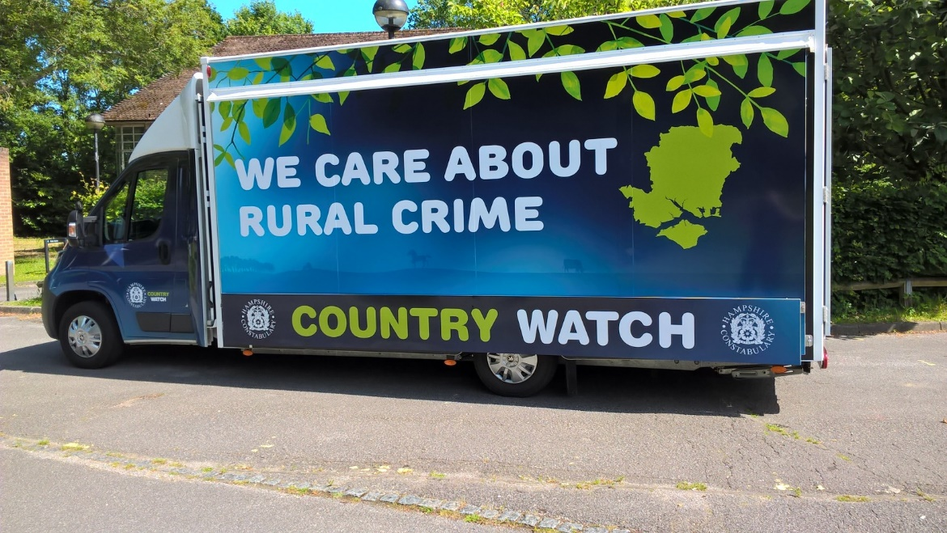
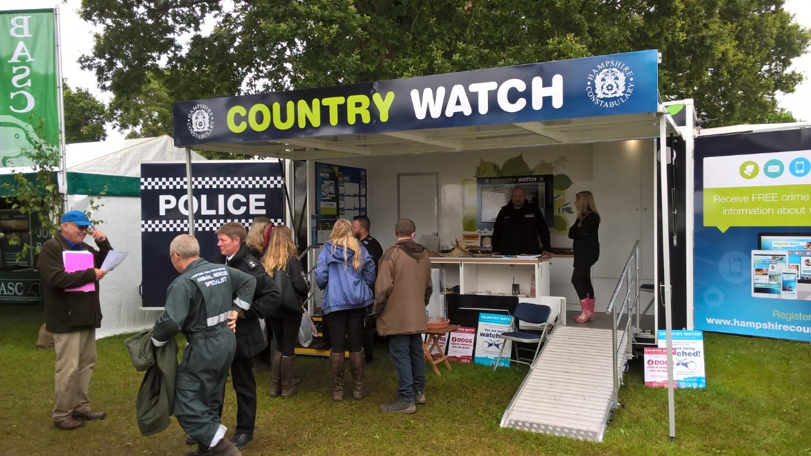
Designated show vehicle for events

Slide 9
Humane Dispatch Scheme
44 Volunteers on the scheme
Called out by control room
Quick resolution and termination of suffering animals
All registered firearms users
Covered by Hampshire's Insurance
Others forces are wanting to replicate

Slide 10
The future…
Continue with pro-active operations
Provision of crime prevention advice
Improved target hardening
Continued investment in staff
Increased community engagement
Build intelligence picture
Notes:
Pro-active operations – get involved
CPA – free service
Target hardening – You can take some measures to reduce the risk of becoming a victim
Investment in staff – call management, CW specials, PSI’s
Community engagement – smart phones – local officers?
Building up Intel – PSI’s /Volunteers
Facebook Cosain overlay around poaching
New Buis Orgs on RMS to collate offences

Slide 11
