Slide 1
NFNPA Update
NPA Local Plan Review
Neighbouring authorities’ Local Plans
Green Halo Partnership
RMS Update

Slide 2

NPA Local Plan Review
Draft Plan to be reported to Authority next week
If agreed, final round of public consultation in January 2018 (six weeks)
Draft Plan submitted to SoS for independent examination in April 2018
Hearing sessions to take place in Summer 2018
Adoption of new Plan in late 2018
Notes:
Crown immunity subject to undertaking a formal consultation with the Local Planning Authority under the provisions of Circular 18/84.

Slide 3
Submission Draft Local Plan
Much of existing local plan remains relevant and up to date; main changes are to the housing policies
Focus very much on meeting local housing needs rather than catering for external demand
Provides for 40 new homes a year
  limited to 100m²
  target for 50% affordable housing
  sites allocated in Ashurst, Lyndhurst, Sway and Fawley/Calshot
Plan has been subject to a full viability appraisal & habitats regulation assessment
Notes:
Undertaken alongside the Local Plan consultation. Aims to identify land that is available for housing; employment and gypsy/traveller use .

Slide 4
Local Plans – neighbouring authorities
LPA | Current local plan adopted in | Status of plan review | OAN
NFDC | 2009 | Advanced | 900 homes pa
TVBC | 2016 | Not commenced | 570 homes pa
Southampton | 2015 | Not commenced | 1115 homes pa
Wiltshire | 2015 | Just started | 2227 homes pa
Christchurch &ED | 2014 | Initial consultation | 626 homes pa
The Government’s revised standardised methodology for calculating OAN (Sept 2017) affects existing OAN numbers, some going up, others down

Slide 5
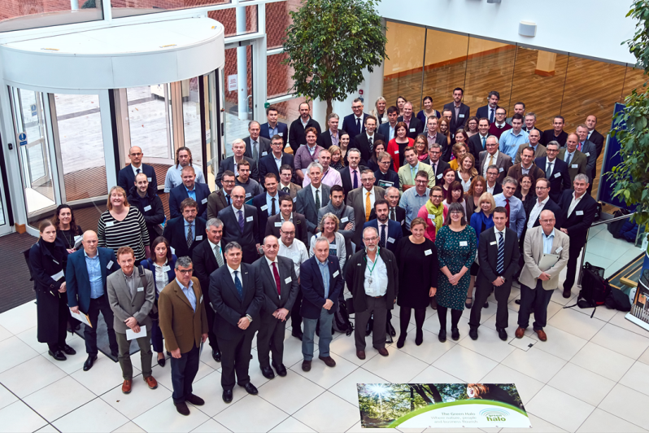

Green Halo Partnership
Brings together organisations from across the wider area to protect and enhance the natural environment
Four key themes:
  Support the local economy
  Improve health and well being
  Encourage sustainable living
  Enhance the natural environment

Slide 6
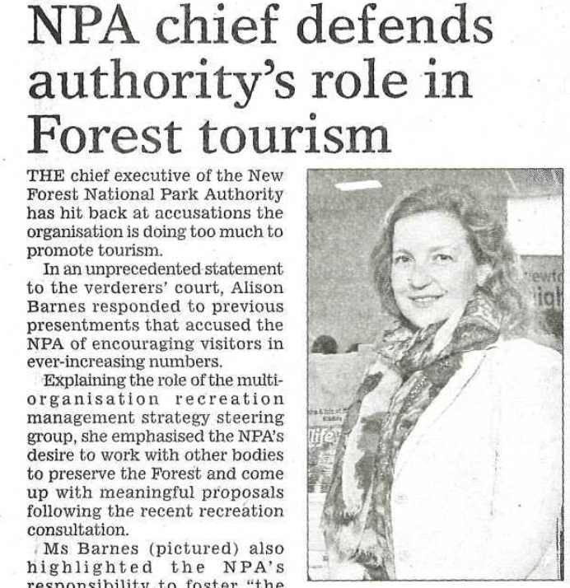
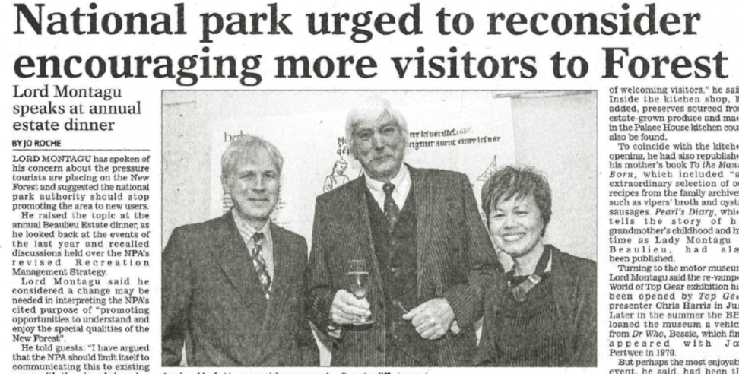
RMS Update

Slide 7


Waterside Development
Commissioning Group tasked Deloitte with producing an economic prospectus for the area
  to include an environmental strategy
Aim is to ensure land and new development brought forward in a coordinated manner
d

Slide 8
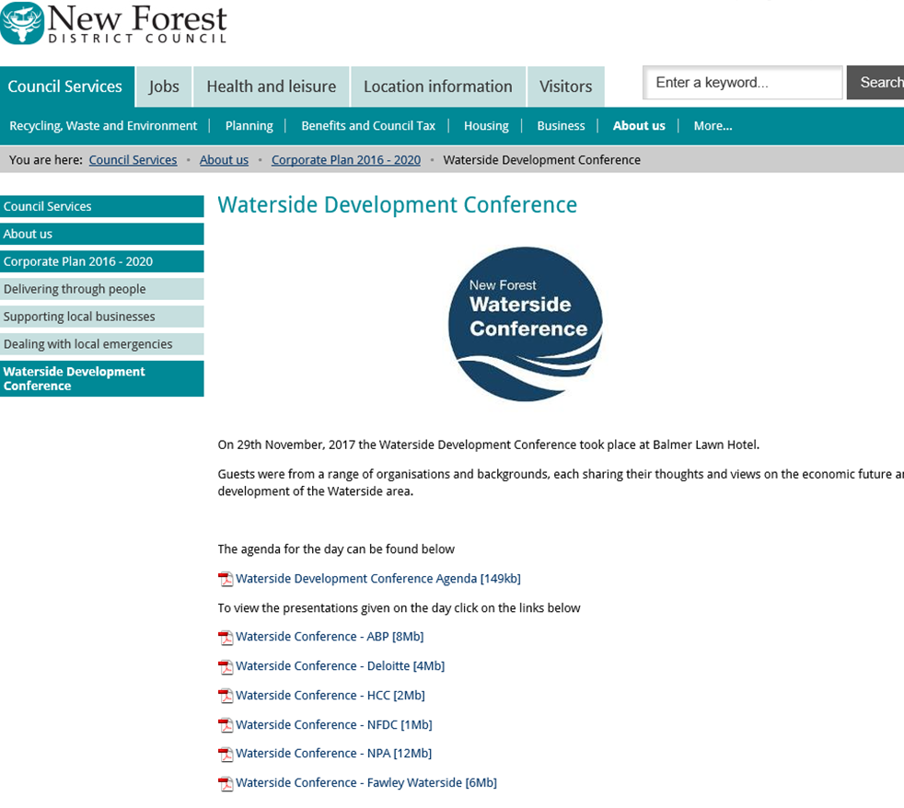
Waterside Development
http://www.newforest.gov.uk/watersideconference

Slide 9
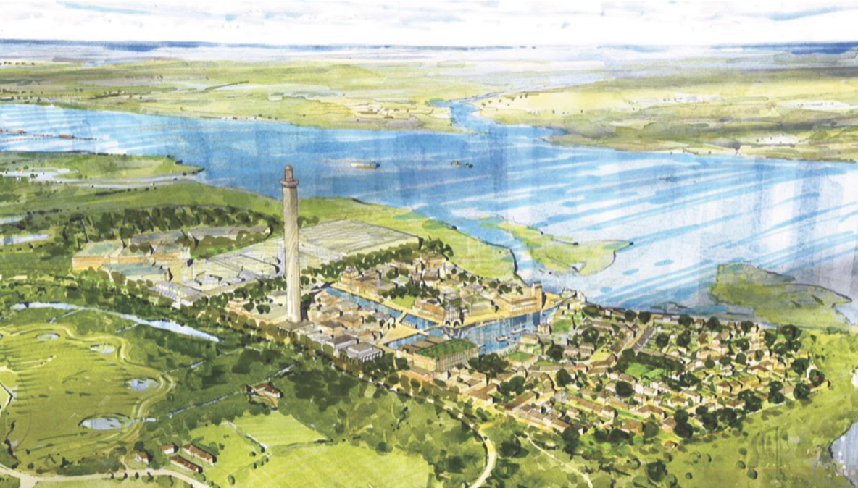
Waterside Development

Slide 10
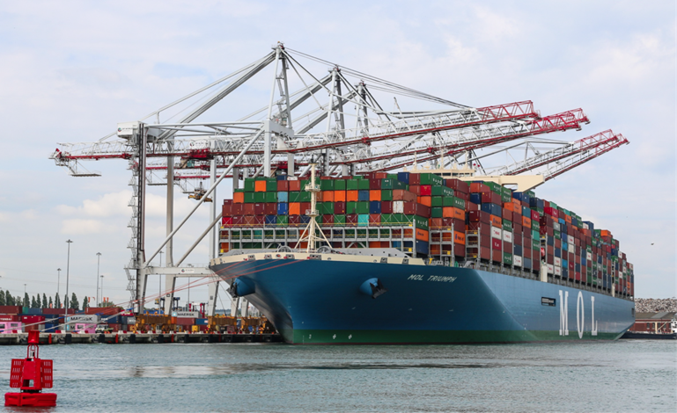
Waterside Development

Slide 11
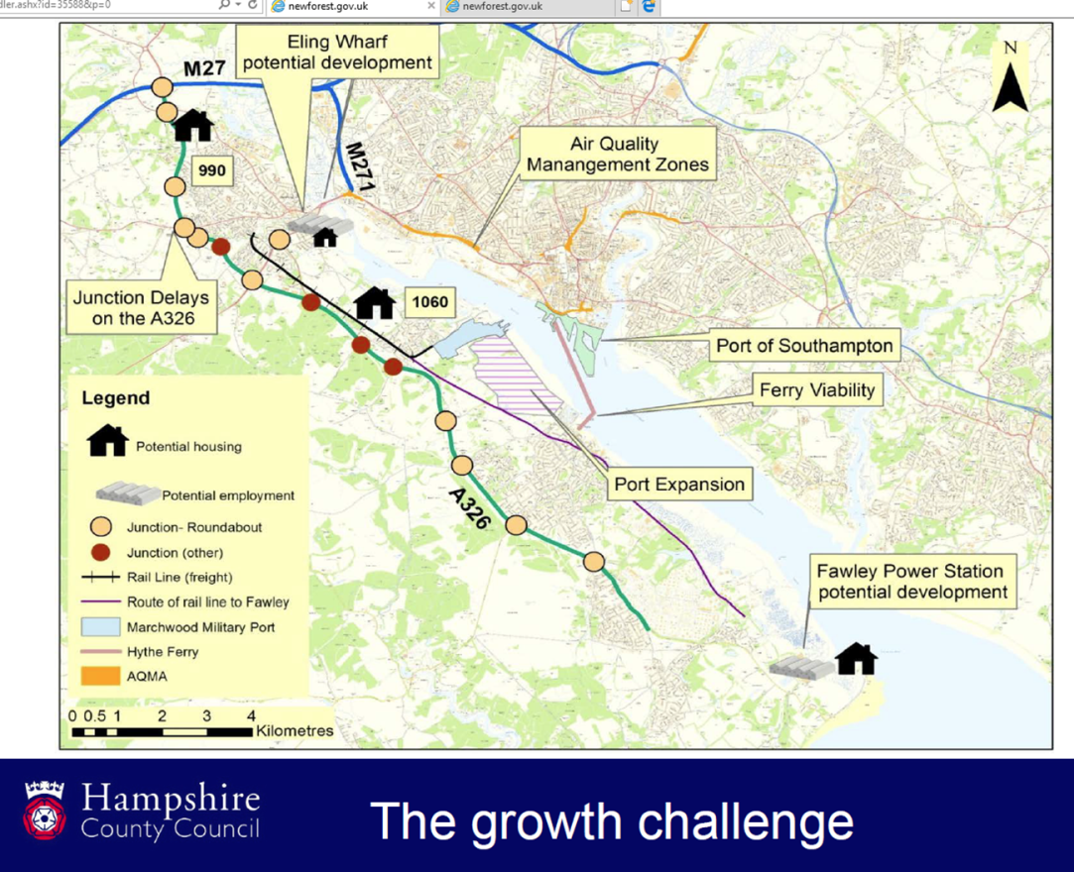
Waterside Development
HCC interim transport position agreed on 14 November 2017
A326 to J2 M27 is the preferred route to the strategic road network from the Waterside
A326 will need to be improved to accommodate future growth
Need to consider impact on the Clear Air Zone designation on the Western Approach to Southampton
Focus on making bus services quicker and more reliable, connecting waterside settlements (and the National Park)

Slide 12
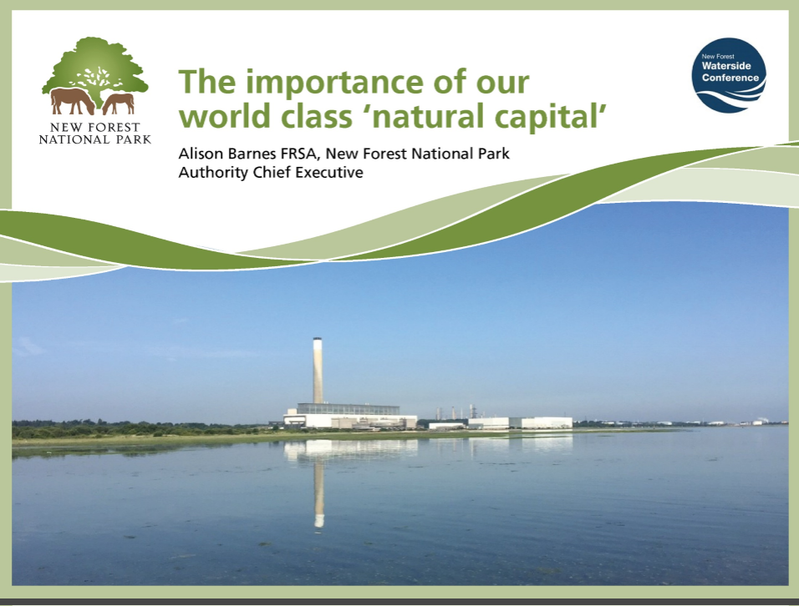
Waterside Development

