Slide 1
Consultative Panel
Update
December 2017

Slide 2
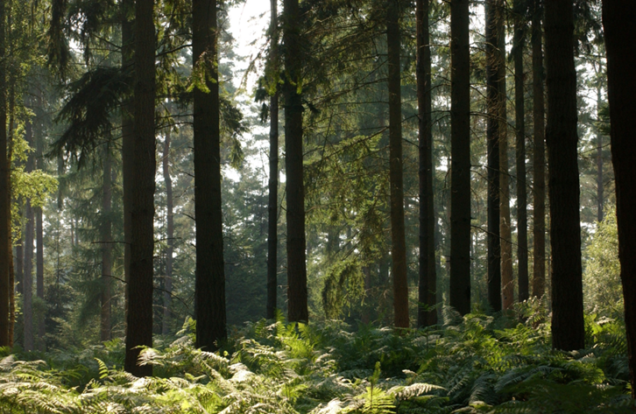
Forest Design Plans - Update
Notes:
The Forest Design Plans – plans that set out the long term structure of the Inclosures of the Forest were submitted to the regulatory authority that approves such woodland plans back in early summer.
They conducted an open public consultation that closed on 31 July. The consultation asked for views on the plans. They also asked for views on whether any of the impacts of clearing trees to restore heathland should be subject to an Environmental Impact Assessment. It is the regulatory authority, Forest Services, who will decide this and we still await their conclusion.
Meanwhile work approved under the previous plan is ongoing and you may have seen work recently completed in the Parkhill area of the central Forest and work in terms of woodland management has now moved on to Hawkhill Inclosure.
Most of the work involves another round of thinning of the existing plantations to move them gently towards the character of woodland specified in our long term vision. This involves the removal of trees to allow others to benefit and develop.

Slide 3
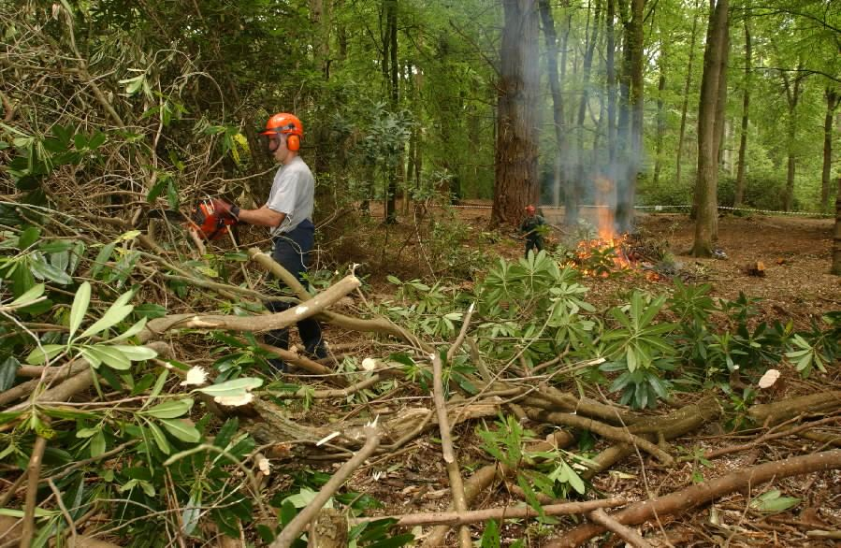
Rhododendron Clearance
Notes:
We have opened our usual campaigns at this time of year to encourage people to “Look but don’t Pick” – appealing to everyone to enjoy the spectacle but leave them for others to enjoy
We are not stopping people picking small amounts for personal use but we will be issuing this leaflet (printed examples provided for members to take away) which explains why the Forest is so important for fungi and encourages people to attend organised forays with experts
It reminds people that commercial picking is an offence under the Theft Act and it is these activities that we want to try to intercept

Slide 4
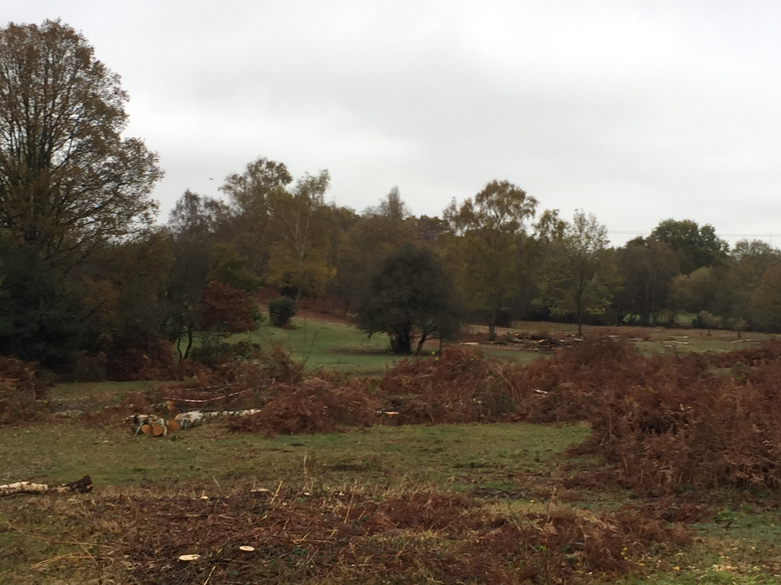
“Lost Lawn” Clearance
Notes:
We have opened our usual campaigns at this time of year to encourage people to “Look but don’t Pick” – appealing to everyone to enjoy the spectacle but leave them for others to enjoy
We are not stopping people picking small amounts for personal use but we will be issuing this leaflet (printed examples provided for members to take away) which explains why the Forest is so important for fungi and encourages people to attend organised forays with experts
It reminds people that commercial picking is an offence under the Theft Act and it is these activities that we want to try to intercept

Slide 5
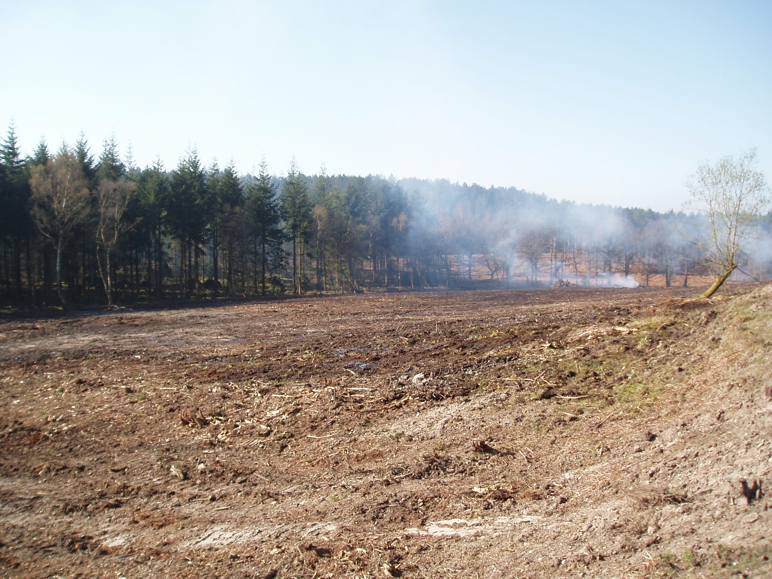
Removal of Ridge and Furrow
Notes:
We have opened our usual campaigns at this time of year to encourage people to “Look but don’t Pick” – appealing to everyone to enjoy the spectacle but leave them for others to enjoy
We are not stopping people picking small amounts for personal use but we will be issuing this leaflet (printed examples provided for members to take away) which explains why the Forest is so important for fungi and encourages people to attend organised forays with experts
It reminds people that commercial picking is an offence under the Theft Act and it is these activities that we want to try to intercept

Slide 6
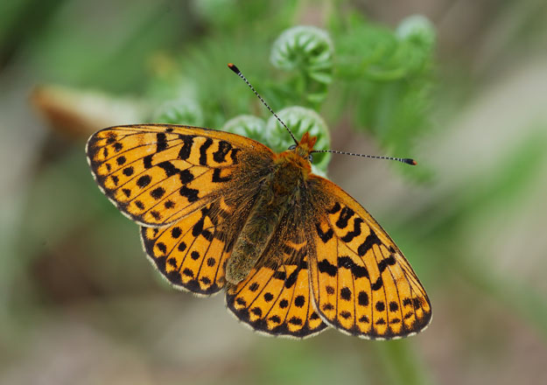
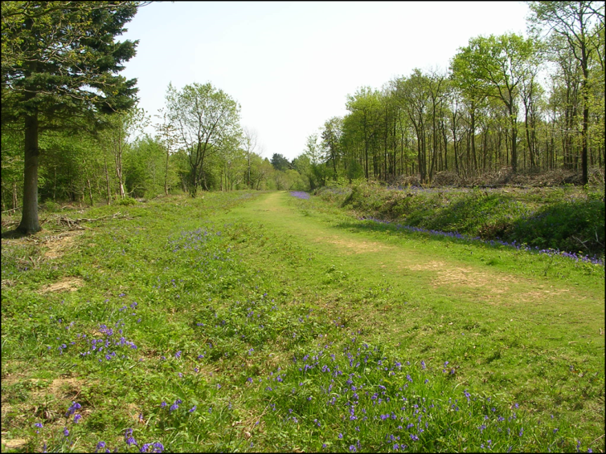
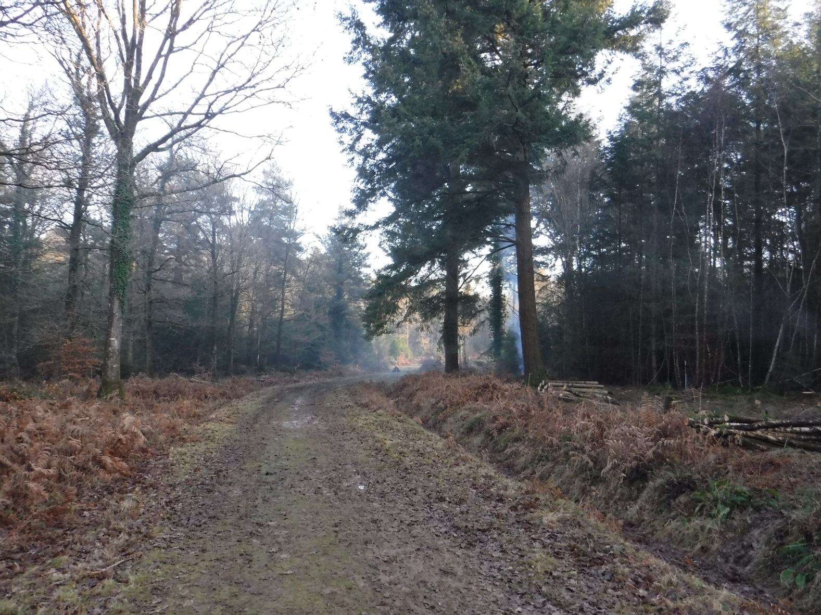
Ride edge work to benefit Fritillaries
Notes:
We have opened our usual campaigns at this time of year to encourage people to “Look but don’t Pick” – appealing to everyone to enjoy the spectacle but leave them for others to enjoy
We are not stopping people picking small amounts for personal use but we will be issuing this leaflet (printed examples provided for members to take away) which explains why the Forest is so important for fungi and encourages people to attend organised forays with experts
It reminds people that commercial picking is an offence under the Theft Act and it is these activities that we want to try to intercept

Slide 7
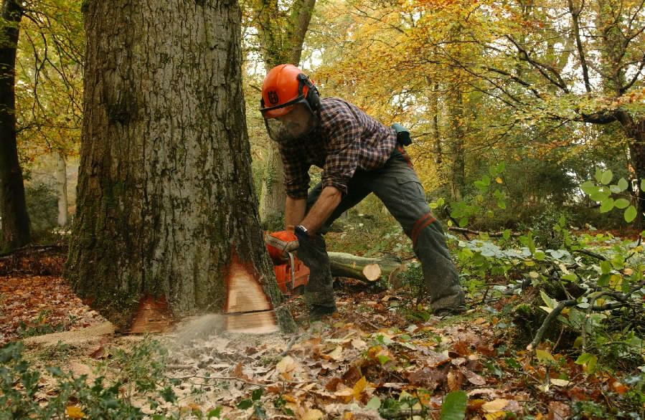
Hardwood Thinning
Notes:
We have opened our usual campaigns at this time of year to encourage people to “Look but don’t Pick” – appealing to everyone to enjoy the spectacle but leave them for others to enjoy
We are not stopping people picking small amounts for personal use but we will be issuing this leaflet (printed examples provided for members to take away) which explains why the Forest is so important for fungi and encourages people to attend organised forays with experts
It reminds people that commercial picking is an offence under the Theft Act and it is these activities that we want to try to intercept

Slide 8
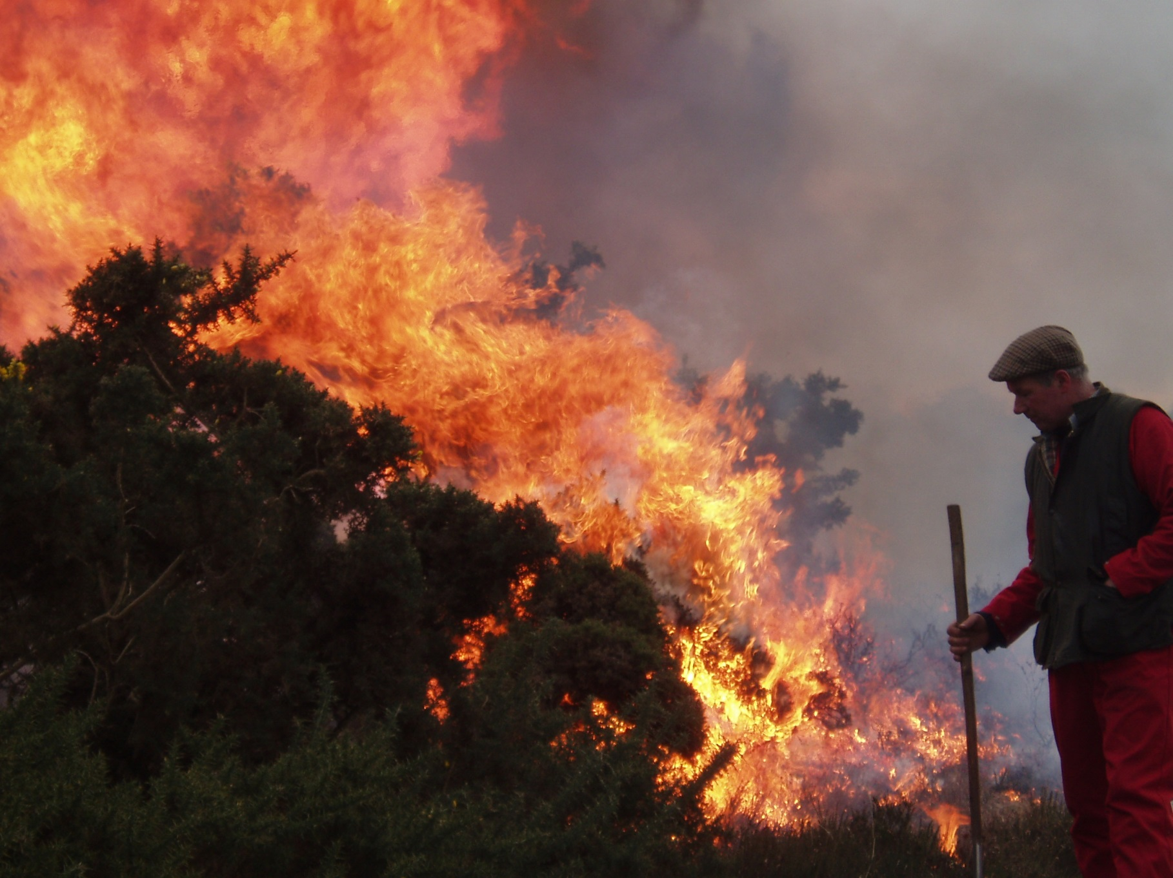
Controlled Burning
Notes:
We have opened our usual campaigns at this time of year to encourage people to “Look but don’t Pick” – appealing to everyone to enjoy the spectacle but leave them for others to enjoy
We are not stopping people picking small amounts for personal use but we will be issuing this leaflet (printed examples provided for members to take away) which explains why the Forest is so important for fungi and encourages people to attend organised forays with experts
It reminds people that commercial picking is an offence under the Theft Act and it is these activities that we want to try to intercept

Slide 9
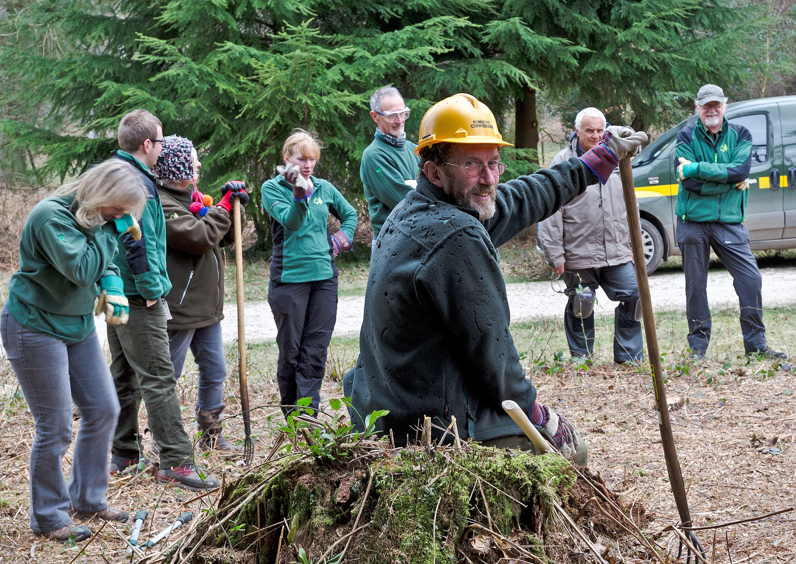
Volunteer Conservation Work
1774 duties planned over next year
Notes:
We have opened our usual campaigns at this time of year to encourage people to “Look but don’t Pick” – appealing to everyone to enjoy the spectacle but leave them for others to enjoy
We are not stopping people picking small amounts for personal use but we will be issuing this leaflet (printed examples provided for members to take away) which explains why the Forest is so important for fungi and encourages people to attend organised forays with experts
It reminds people that commercial picking is an offence under the Theft Act and it is these activities that we want to try to intercept

Slide 10
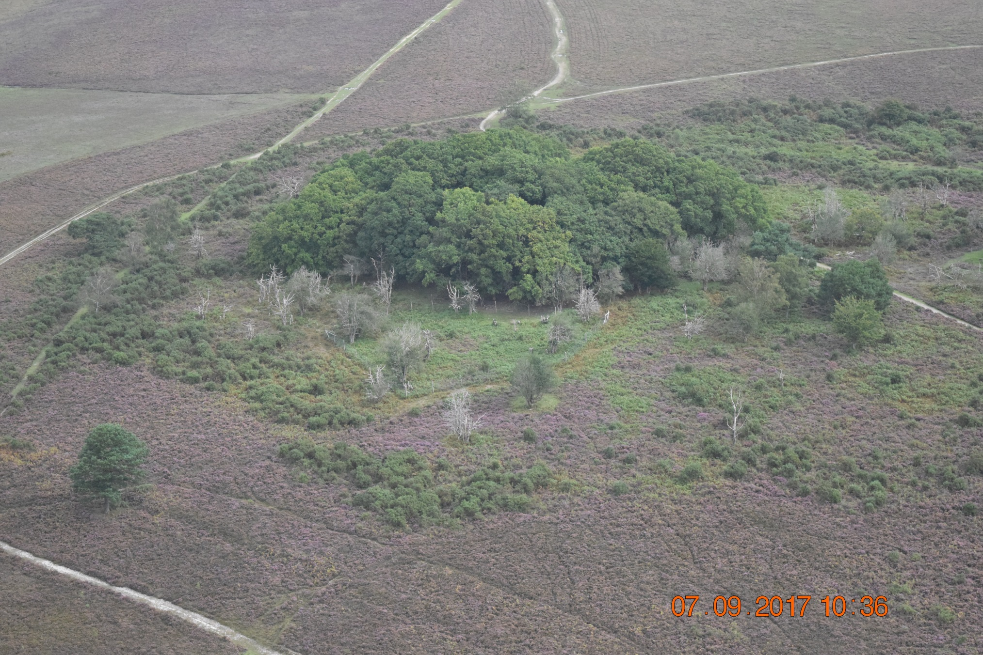
Health of Holly
Notes:
We have opened our usual campaigns at this time of year to encourage people to “Look but don’t Pick” – appealing to everyone to enjoy the spectacle but leave them for others to enjoy
We are not stopping people picking small amounts for personal use but we will be issuing this leaflet (printed examples provided for members to take away) which explains why the Forest is so important for fungi and encourages people to attend organised forays with experts
It reminds people that commercial picking is an offence under the Theft Act and it is these activities that we want to try to intercept

Slide 11
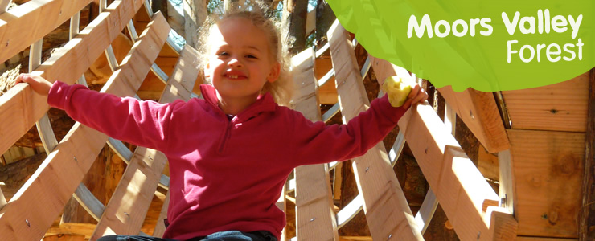
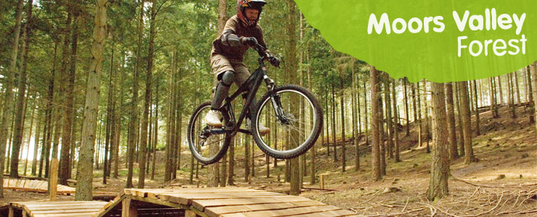
Moors Valley Country Park
Notes:
We have opened our usual campaigns at this time of year to encourage people to “Look but don’t Pick” – appealing to everyone to enjoy the spectacle but leave them for others to enjoy
We are not stopping people picking small amounts for personal use but we will be issuing this leaflet (printed examples provided for members to take away) which explains why the Forest is so important for fungi and encourages people to attend organised forays with experts
It reminds people that commercial picking is an offence under the Theft Act and it is these activities that we want to try to intercept

