Slide 1
National Park Update
6 June 2024

Slide 2
Local Plan Review

Slide 3
Local Plan Review – partial or full review?
Local plans should be reviewed to assess whether they need updating at least once every five years and should then be updated as necessary
NPA Members considered report AM 675/24 in March 2024 and resolved to commence a partial review of the Local Plan
Key aspects of national policy, guidance and law relating to National Parks remain unaltered from the time the Plan was adopted. For example:
the two statutory National Park purposes and related duty remain unaltered;
key elements of the National Planning Policy Framework (NPPF) relating to National Parks are unchanged; and
the legal protection afforded internationally designated sites remain in place.

Slide 4
Context – ongoing planning reforms
The Levelling Up & Regeneration Act 2023 (LURA) proposes the abolition of Supplementary Planning Documents. A partial review of the Plan would enable relevant sections of existing SPDs to be incorporated into the revised plan.
The Government has published proposed reforms to the Plan-making system, with a mandatory 30-month period for production. Further details are awaited.
LURA introduced a new category of planning policies - national development management policies (NDMPs) – these will carry the same weight as policies within local plans and in the case of a conflict between the two, NDMPs will override local plans. Further detail is awaited on these policies, including the timetable for their implementation and the topics to be covered.

Slide 5
Scope of the review
There have been some revisions to national policy and legislation relevant to our planning work that a partial Local Plan review provides the opportunity to address.
For example, recent changes in national Permitted Development rights mean a review of some policies would be beneficial.
A focused review of our local planning policies on sustainable construction, climate adaption and energy efficiency will enable us to consider the Climate Emergency.
The preparation of Local Nature Recovery Strategies (Wiltshire and Hampshire) and the mandatory requirement for Biodiversity Net Gain are relevant.
Updated evidence on housing needs arising within the National Park will be required and options considered for how to address this within a protected landscape.

Slide 6
Likely topics to be in scope of the review
Improved energy efficiency and making use of small-scale renewable energy – this follows NPA declaration of the Nature & Climate Emergency.
The proposed abolition of SPDs may mean more detail on the mitigation schemes for the New Forest and Solent needs to be within the Plan.
Consider the need for a local Design Code and the relationship with the existing Design Guide SPD.
Future housing needs – will we be required to allocate any new sites?
Detailed policies on replacement dwellings, extension and outbuildings.
Protecting back up grazing land and support for commoning.
Visitor accommodation – campsites and second homes.
Need to reflect emerging Local Transport Plans for Hampshire & Wiltshire.

Slide 7
Next steps
Report to full Authority meeting on 15 July 2024 setting out a proposed timetable

Slide 8
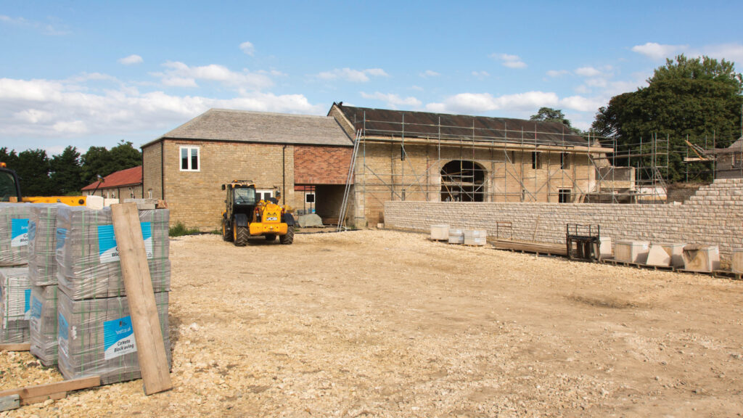
New PDRs for farm buildings
Changes to permitted development rights – Farming (blog.gov.uk)

Slide 9
New permitted development rights came into force on 12 May 2024
Followed an earlier Government consultation last year
National Parks continue to be exempt from existing PDR that allows farm buildings to convert to housing
But maximum size of new PDR farm buildings increased from 1,000 square metres to 1,500 square metres (on farms over 5 hectares)
The amount of floorspace that can change from agricultural use to ‘flexible commercial use’ increased from 500 square metres to 1,000 square metres
Wider range of ‘flexible commercial uses’ now permitted

Slide 10
The Waterside – report commissioned by NPA
To assess opportunities to re-connect the habitats and landscape character between the New Forest National Park and Southampton Water
To examine imaginative ways to re-introduce commoning, and ecological and landscape connectivity
To protect historic links between the Open Forest and the Waterside

Slide 11
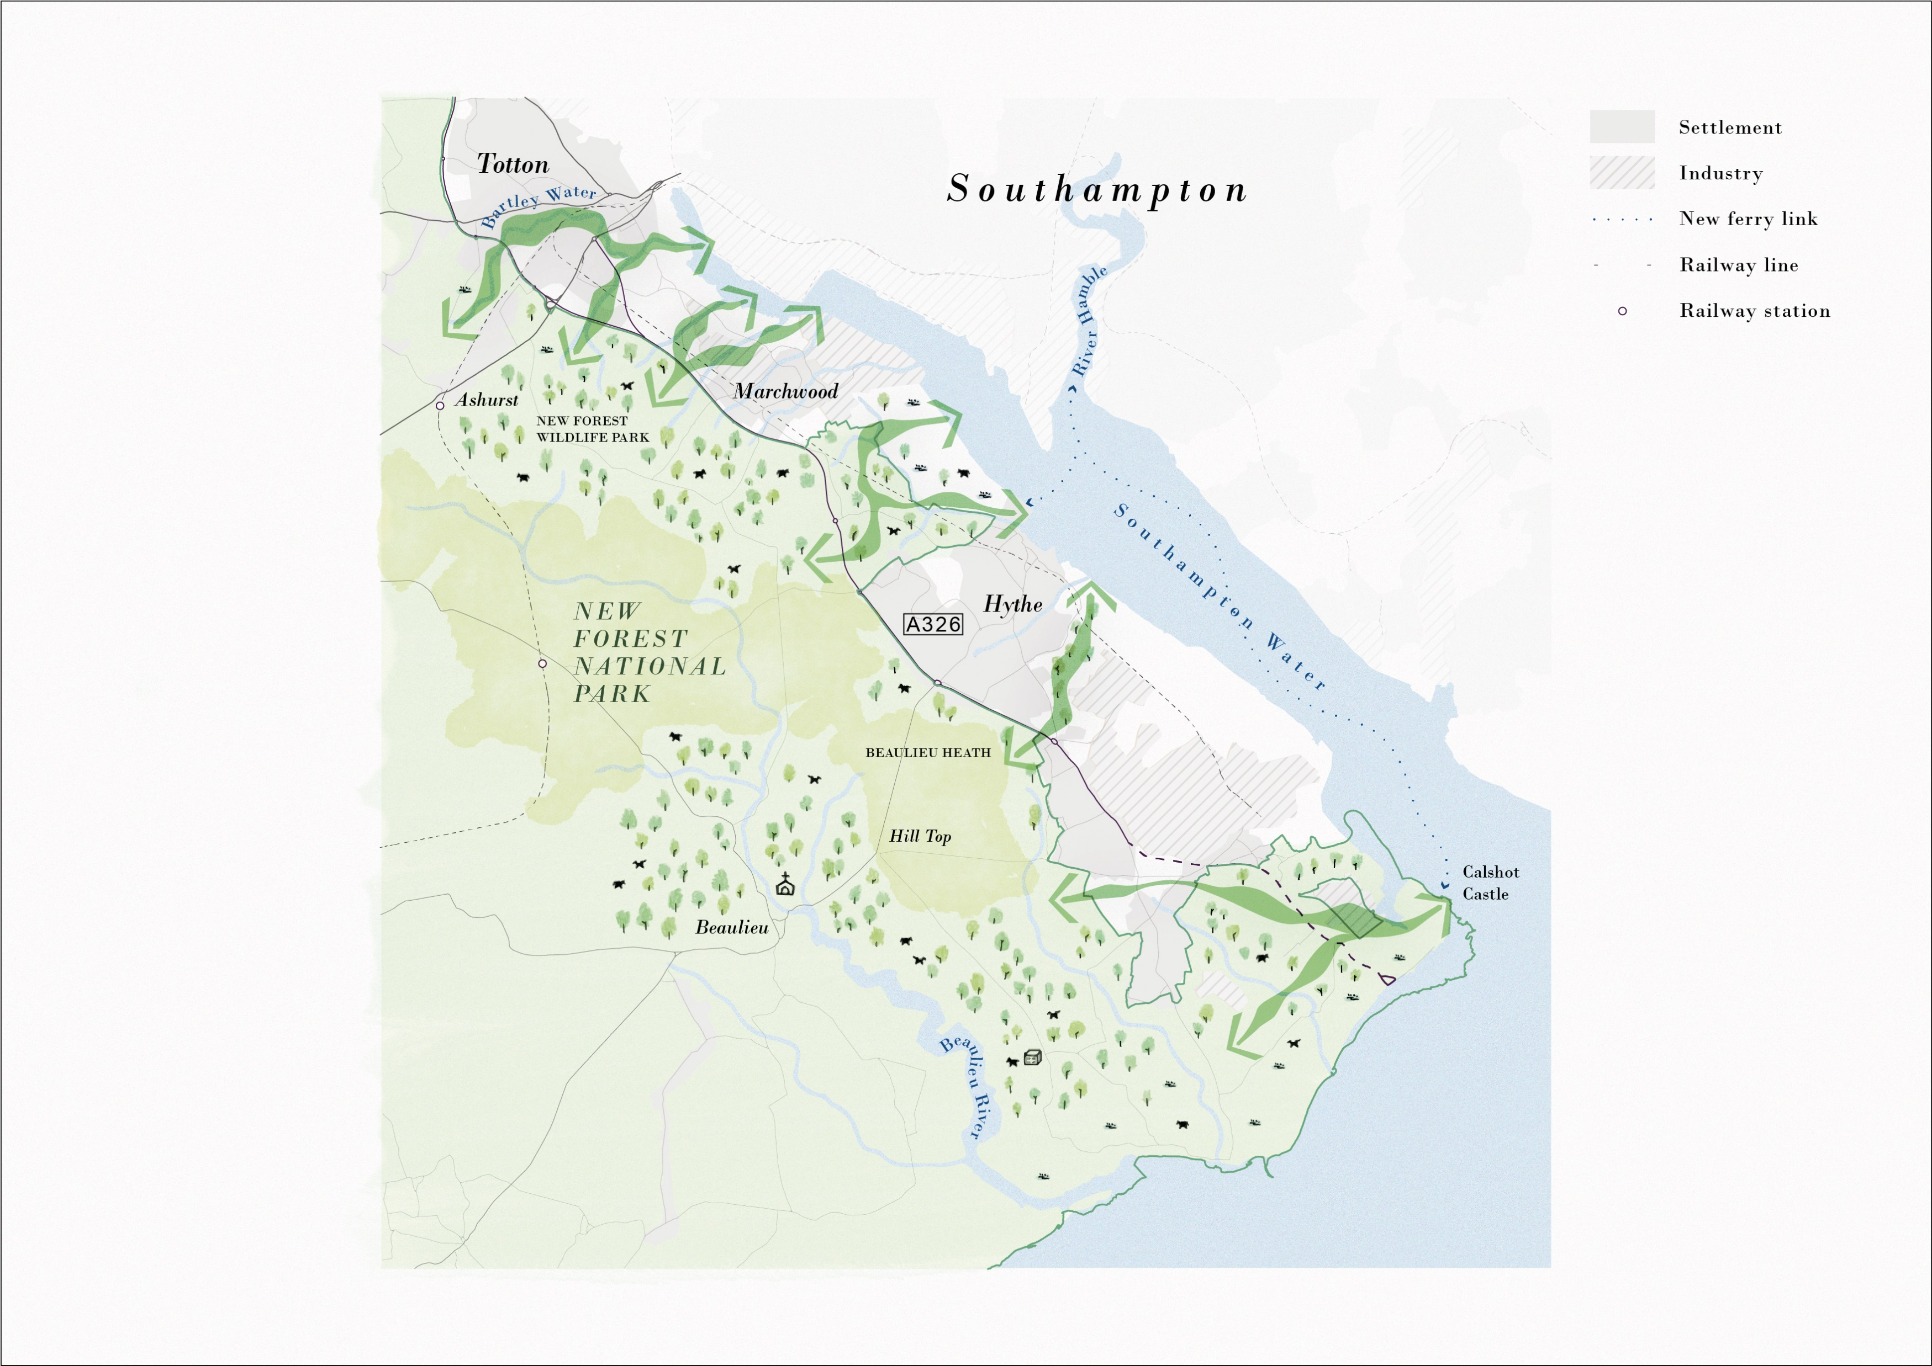
Green Links
Five Green Links
1
2
Green Link 1 – Totton to Ashurst
Green Link 2 – Marchwood to Open Forest
Green Link 3 – Dibden Bay to Beaulieu River
Green Link 4 – Hythe to Beaulieu Heath
Green Link 5 – Calshot to Beaulieu River
3
4
5

Slide 12
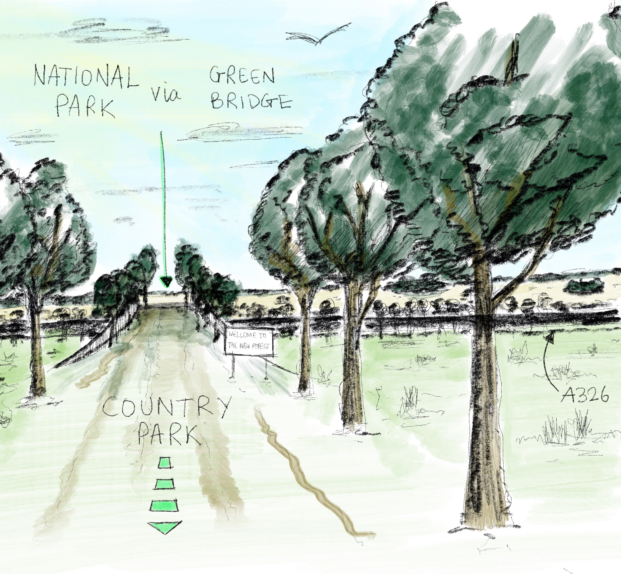
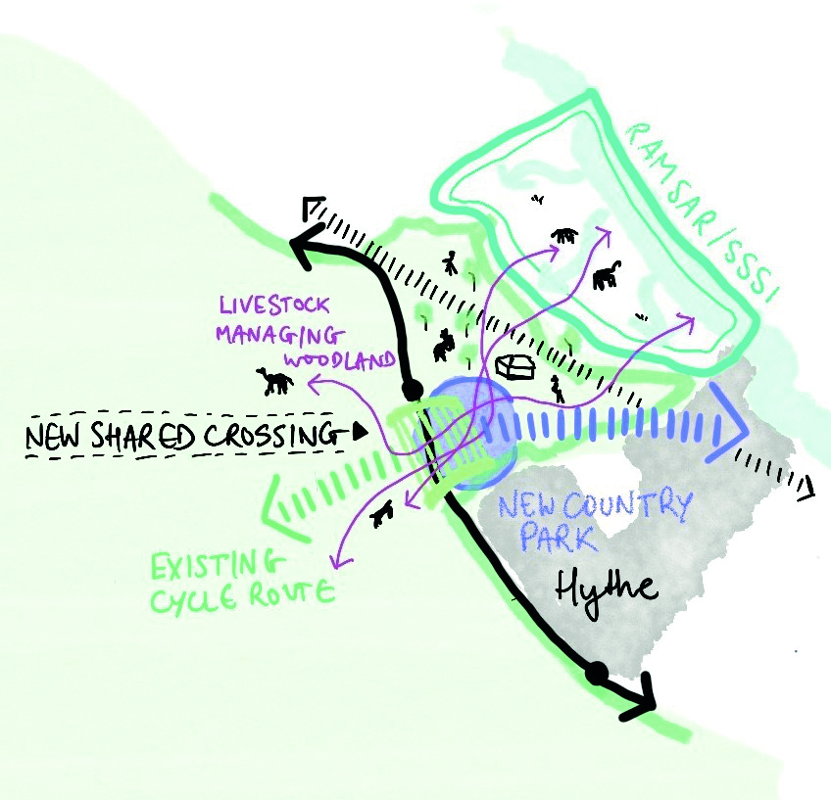
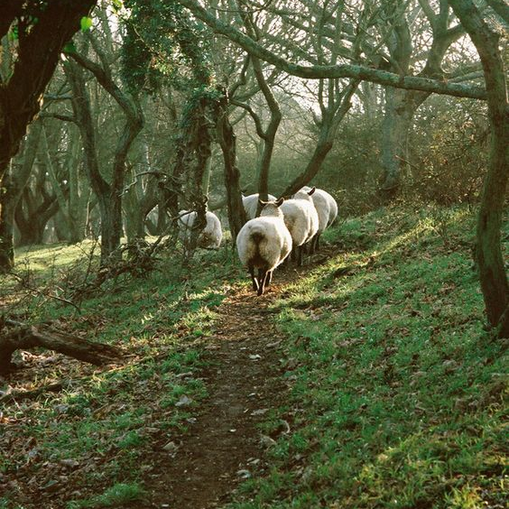
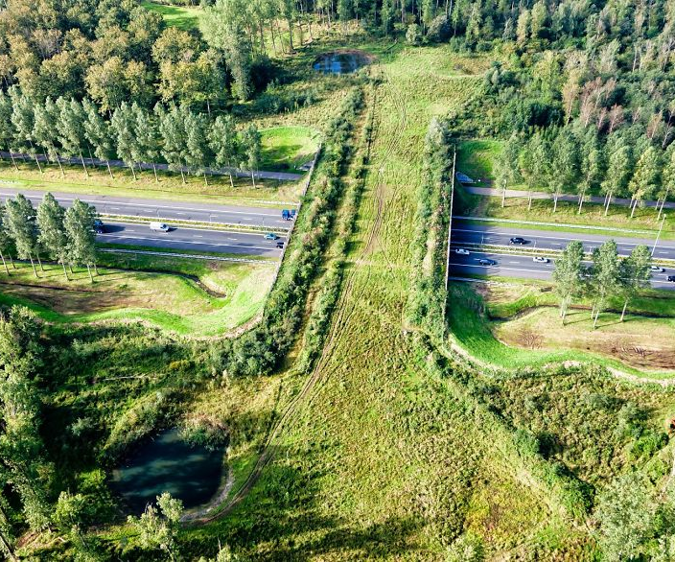
Green Link 3: Dibden Bay to Beaulieu River
3

Slide 13
In other news…
New planning enforcement rules came into force in April; these include unlimited fines for those who don’t comply with enforcement notices, and a longer period in LPAs can take enforcement action against some unauthorised development – with the previous four-year limit now extended to 10 years.
Referendums relating to the adoption of the Ringwood and Wellow Neighbourhood Plans will be held respectively on 4 and 11 July 2024.
Green Halo Conference on 12 June 2024 “National Parks for Health: A Natural Health Service” (Beaulieu Inn Hotel, Beaulieu Road, Brockenhurst)

Slide 14
National Park Update
6 June 2024

