Slide 1
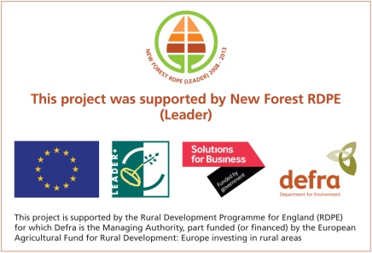
Community Wildlife Plans Project
Group survey pic
New Forest Land Advice Service
Community Wildlife Plans Project

Slide 2
Community Wildlife Plans Project funders
New Forest Land Advice Service

Slide 3
Community Wildlife Plans Project areas
New Forest Land Advice Service
Community Wildlife Plans Project

Slide 4
Project Targets
Galvanise local interest
Look at existing data and local resource
Deliver relevant training
Organise and deliver Bioblitzes
Support volunteer involvement in the project
Deliver some practical environmental on the ground benefits
Develop a mapping tool for communities to map wildlife and habitats in their local areas.
Collate survey data and resources and work up ‘Community Wildlife Plans’ for each community.
Ensure mechanisms in place to ensure these communities can continue this work into the future.
New Forest Land Advice Service
Community Wildlife Plans Project

Slide 5
Deliver relevant training
Determine what the communities want and need
Organise training sessions, venues, experts, resources, publicity
Deliver training
Follow up: Support community groups/individuals delivering surveys
New Forest Land Advice Service
Community Wildlife Plans Project

Slide 6
The project in numbers...
4 practical events
6 talks at Council meetings or to community groups
13 workshops and training sessions
2 x 24 hour Bioblitzes
1 display at a public event
Total number of attendances to the above is just over 600, but about 200 individuals involved.
New Forest Land Advice Service
Community Wildlife Plans Project

Slide 7
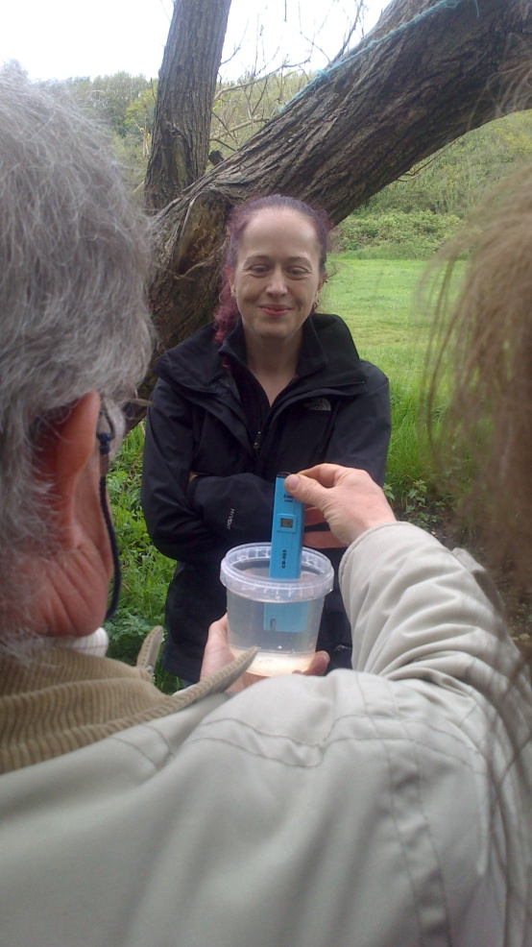
Catchment project – Becton Bunny

Slide 8
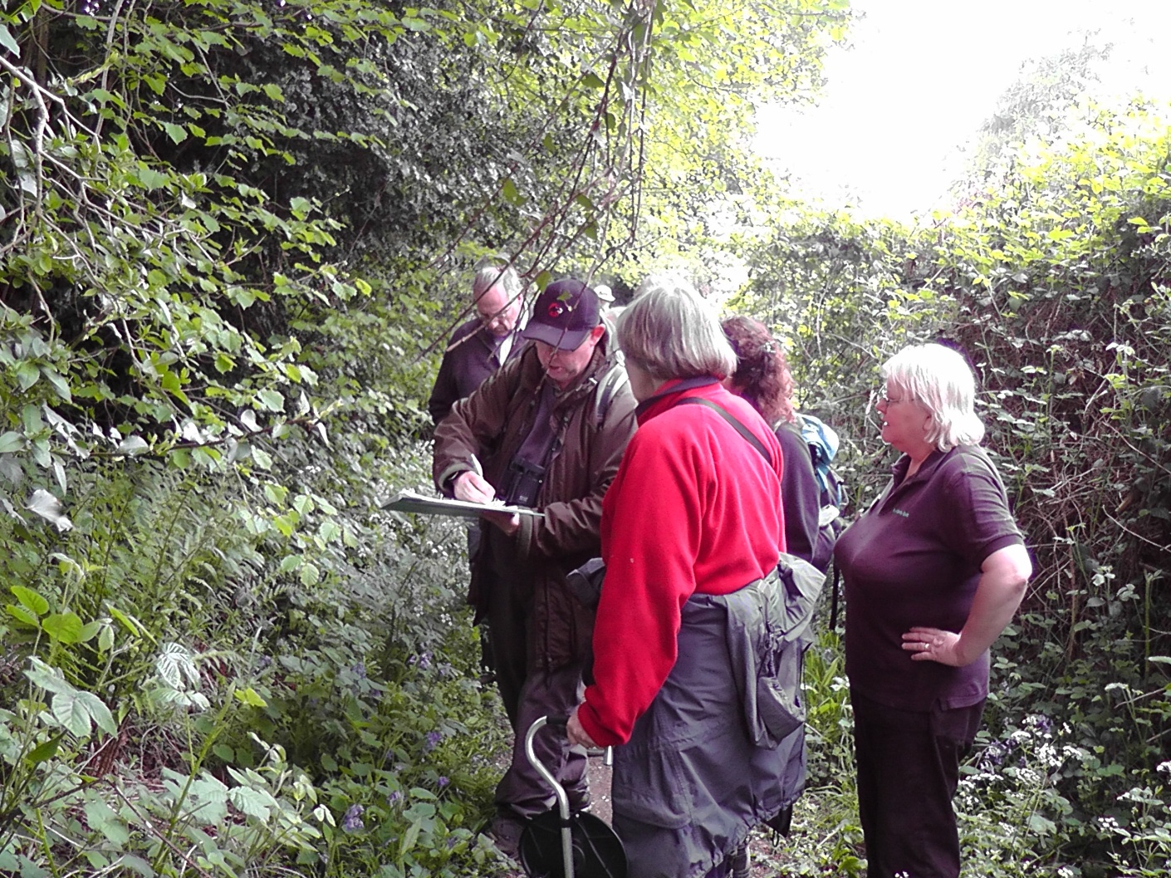
Surveying hedgerows
New Forest Land Advice Service
Community Wildlife Plans Project

Slide 9
Veteran tree surveys
New Forest Land Advice Service
Community Wildlife Plans Project

Slide 10
Aquatic invertebrates
New Forest Land Advice Service
Community Wildlife Plans Project

Slide 11
Pond monitoring
New Forest Land Advice Service
Community Wildlife Plans Project

Slide 12
Mapping balsam on the Blackwater
New Forest Land Advice Service
Community Wildlife Plans Project

Slide 13
On-line wildlife mapping tool – ‘LivingRecord’
New Forest Land Advice Service
Community Wildlife Plans Project

Slide 14
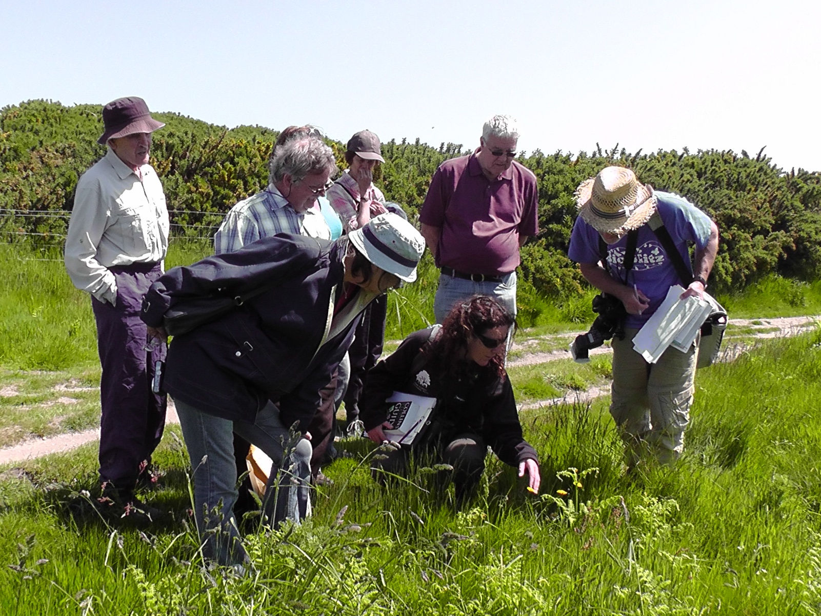
Bioblitzes
New Forest Land Advice Service
Community Wildlife Plans Project

Slide 15
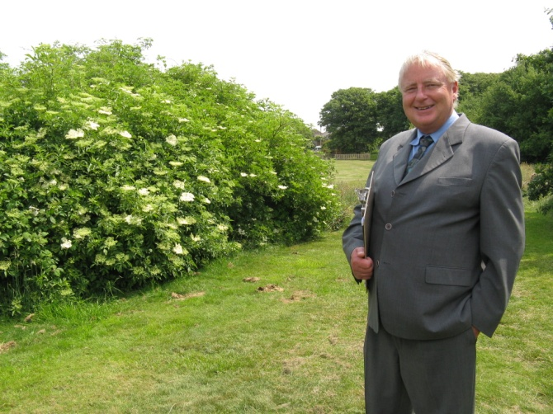
Becton Bunny
New Forest Land Advice Service
Community Wildlife Plans Project

Slide 16
Woodland management
New Forest Land Advice Service
Community Wildlife Plans Project

Slide 17
Himalayan balsam pulling on the River Blackwater
New Forest Land Advice Service
Community Wildlife Plans Project

Slide 18
Community Wildlife Plans - action now
Summarise wildlife data for each area
Summarise resources for community groups
Methods for surveys and local experts and organisations.
Source of funding that groups can look to fund projects
Management plans for their local areas
New Forest Land Advice Service
Community Wildlife Plans Project

Slide 19
Community Wildlife Plans – challenges, opportunities
3 key challenges
3 key opportunities
Timescale
Project slow to start in some areas
Well-loved and well-used public sites, can take time to agree on a way forward
Overall an excellent level of interest in the communities worked in, and positive feedback
Big resource of hidden skills out there, can be put to good use with benefits all round
Connecting habitats and improving habitat quality – a lot of opportunities that could be worked on with the communities at the heart

Slide 20
Community Wildlife Plans –and the future
We want to continue this work and build on the success
Funding
NF Land Advice Service can fund some of this work until march 2013.
NF NPA Corporate funding officer is seeking future funding for this project.
Other sources – let me know!
Do register your interest with me if you think this is something your community might want to get involved in. Am happy to discuss opportunities!
have some funds to continue

Slide 21
Thank you
http://www.newforestnpa.gov.uk
Angela.peters@nflandadvice.org.uk
01590 646654
07880 197351
New Forest Land Advice Service
Community Wildlife Plans Project

