Slide 1
The Verderers of the New Forest Higher Level Stewardship Scheme
Car free ditching and Verge Protection
Car free ditching has been taking place
across the Open Forest to deter
unauthorised vehicle access which can
damage SSSI habitats and reduce the
grazing resource.

Slide 2
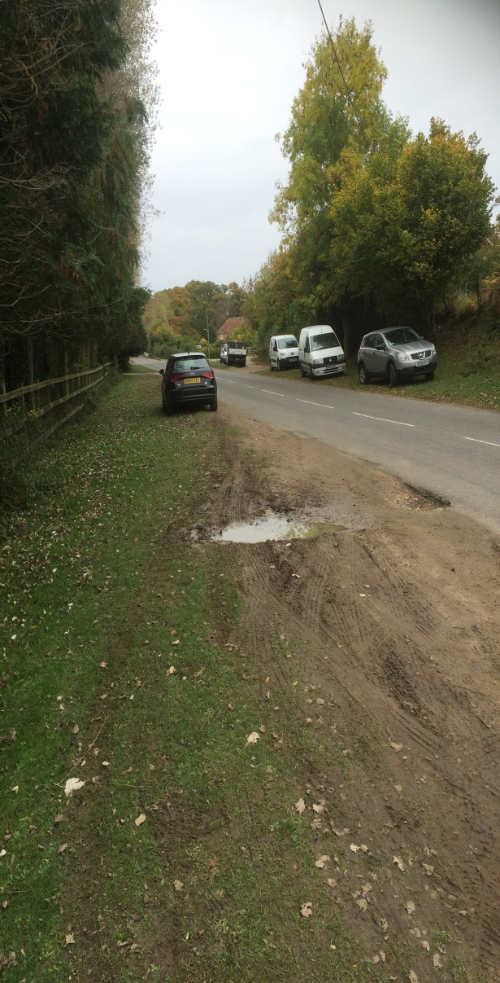
New Forest HLS scheme Verge Protection project
• The project is now being extended to grazed verges in and around villages where damage is occurring through parking, overrun of vehicles and storage of building materials.
• To protect these verges from further damage the New Forest HLS scheme is funding the installation of dragons teeth and use of ditching where appropriate.

Slide 3
New Forest HLS scheme Verge Protection project
• The Western Escarpment Conservation Area steering group have long recognised the problem with verge damage and have produced a leaflet about verge protection.

Slide 4
New Forest HLS scheme Verge Protection project
• Woodgreen Parish Council decided that they wanted to do something about the damage and has worked collaboratively with the Verderers and Forestry Commission.
Maps were marked up by the PC, a joint site visit made and then FC drew up work plan maps.

Slide 5
New Forest HLS scheme Verge Protection project
• If you wish to put forward any damaged grazed verges that need protecting please contact:
Gary.North@forestry.gsi.gov.uk
0300 067 4635 Direct line

