Slide 1
New Forest National Park Local Plan Review

Slide 2
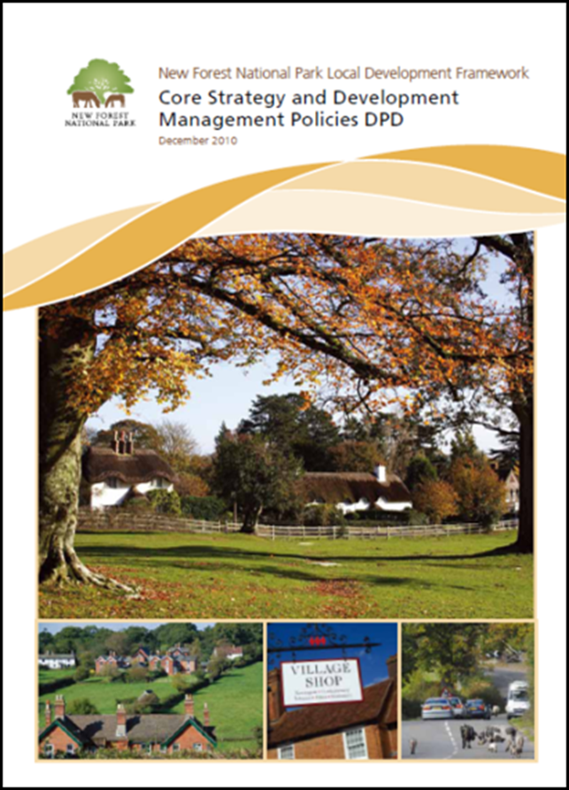
This evening
Recap on work undertaken to date
Some key issues and challenges
Initial draft local plan
the main changes proposed
Timetable and next steps
Notes:
Crown immunity subject to undertaking a formal consultation with the Local Planning Authority under the provisions of Circular 18/84.

Slide 3
Work undertaken to date
Initial six week public consultation last September to help inform scope of review and identify key issues
Comments received from over 60 respondents, including statutory consultees, constituent authorities, town/parish councils and residents
Detailed comments made on areas including:
support for the protection of employment sites;
support for the existing settlement hierarchy;
detailed comments on policies on extensions, replacement dwellings, outbuildings and renewable energy;
the need to review habitat mitigation measures linked to the scale of development .

Slide 4
Work undertaken to date
“Call for Sites”
A total of 120 sites put forward by local landowners and developers during the initial consultation.
Sites include land within or adjacent to 22 villages amounting to circa 2,000 dwellings
All of the submitted sites have been assessed to determine their suitability
Notes:
Undertaken alongside the Local Plan consultation. Aims to identify land that is available for housing; employment and gypsy/traveller use .

Slide 5
Work undertaken to date
Various meetings with Parish Councils – through NFALC and parish quadrants
Topic based workshops
Historic environment
Business and employment
Commoning
Role of the larger Estates
Liaison with neighbouring authorities
Discussions with statutory consultees

Slide 6
Some key considerations
New Local Plan needs to take account of national planning policy
Much of existing local plan remains relevant and up to date
core policies continue to be supported on appeal
Opportunity to ‘fine tune’ some policies based on experience of last 5 years

Slide 7
Some key challenges
Conserving and enhancing a naturally protected landscape
Avoiding and mitigating impacts of new development on protected habitats
Preventing loss of local distinctiveness and heritage assets
Supporting new housing for local needs
no longer able to seek affordable housing on schemes of 5 dwellings or less

Slide 8
Content of new local plan
Include executive summary
Set out its relationship with other plans, e.g. the new Partnership Plan, existing RMS
New policy on major development
Fawley Power Station
Dibden Bay
Retain existing structure and chapter headings

Slide 9
Protecting & enhancing the natural environment
A number of policies remain largely unaltered e.g. international, national & local wildlife sites
Policies on green infrastructure and local greenspaces updated to reflect likely future SANG applications
Policies on climate change and renewable energy updated to clarify the appropriate scale of renewable energy schemes
New policy areas include: (i) landscape character; (ii) trees, woodlands & hedgerows; and (iii) tranquillity
Notes:
This section of the Local Plan works well and largely conforms to national policy. A few minor amendments are proposed.

Slide 10
The built & historic environment
Requires an update following changes to national planning policy since 2010
Heritage assets – national policy is clear that Local Plans should set out policies for the range of ‘heritage assets’ (e.g. Conservation Areas, Listed Buildings)
Local distinctiveness & design – these policies are now supported by the Design Guide SPD and VDSs.
New reference to the importance and contribution of the Forest verges and the need to protect them from encroachment
Notes:
On operational crown land for operational purposes

Slide 11
Vibrant communities
Changes required to reflect the Government’s requirement to meet “objectively assessed housing needs” (OAN) where possible
For the National Park, the OAN is 140 – 164 dwellings per year
Existing plan provides for 11 dwellings per year (housing completions averaging 20 dwellings per year)

Slide 12
Vibrant communities
Draft plan looking to deliver 700 new dwellings over plan period (35 per year)
Retain the existing settlement hierarchy of the four defined villages of Ashurst, Brockenhurst, Lyndhurst & Sway
New policy areas include:
site specific housing allocations (220 dwellings)
limiting the size of new housing (100m²);
stand alone policy on commoners dwellings; and
new policy for Estate workers housing.

Slide 13
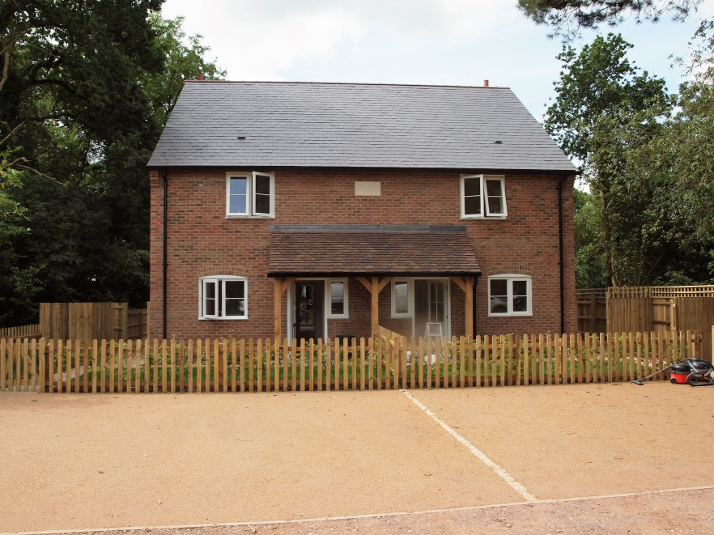
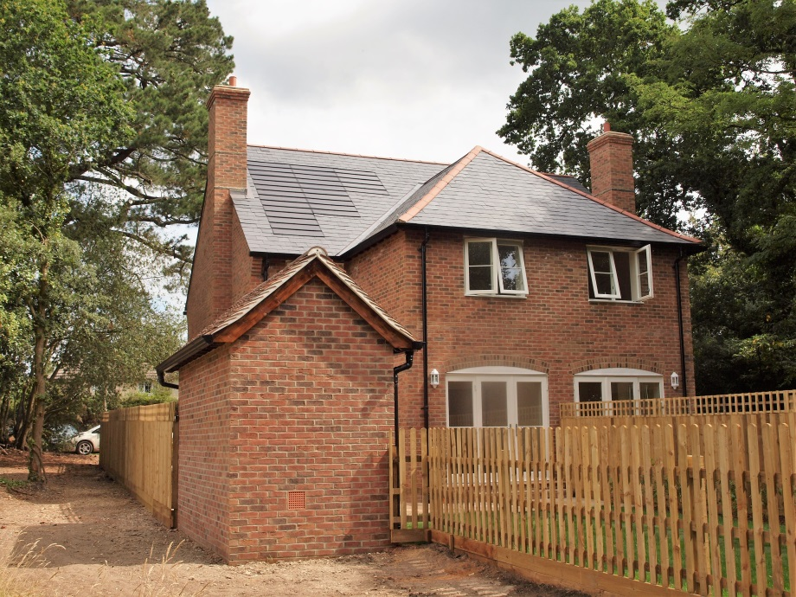
Estate workers’ housing
Need to be part of an Authority endorsed Estate Plan delivering multiple benefits
Subject to size restriction and occupancy condition
Tenure will be private rented accommodation
Re-use of redundant buildings encouraged over new build
Small scale housing schemes not exceeding 3 units

Slide 14
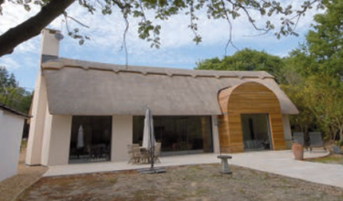
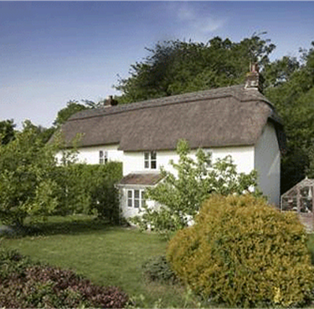
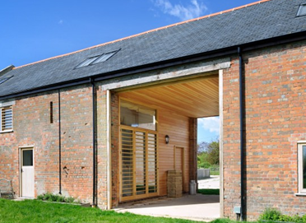
Vibrant communities
Detailed policies on (i) replacement dwellings; (ii) extensions and (iii) outbuildings largely unaltered.
Rural exceptions sites policy to be retained

Slide 15
A sustainable local economy
This section of the Local Plan works well and conforms to national policy.
The existing policies on (i) safeguarding existing employment sites; (ii) tourism development; (iii) the redevelopment & extensions to existing employment sites; (iv) recreational horsekeeping; and (v) farm diversification to remain largely unaltered.

Slide 16
Transport & access
The NPPF does not include maximum parking standards and therefore our Local Plan will need to set out parking standards.
A number of NPAs safeguarding disused railway lines from development that would compromise their future use as alternative transport routes.
The England Coastal Path will include land within the National Park and the Local Plan will include coverage of this.

Slide 17
Next steps
Initial draft plan to be reported to the Authority meeting on 22 September
Public consultation will run for eight weeks from 3 October – 28 November
Series of public ‘drop in’ sessions
Ongoing engagement with New Forest forums and groups

Slide 18
Timetable
Notes:
These have all been reported to PDCC as NPA a member of HLS Board

Slide 19
New Forest National Park Local Plan Review
Notes:
Crown immunity subject to undertaking a formal consultation with the Local Planning Authority under the provisions of Circular 18/84.

